Slide 3
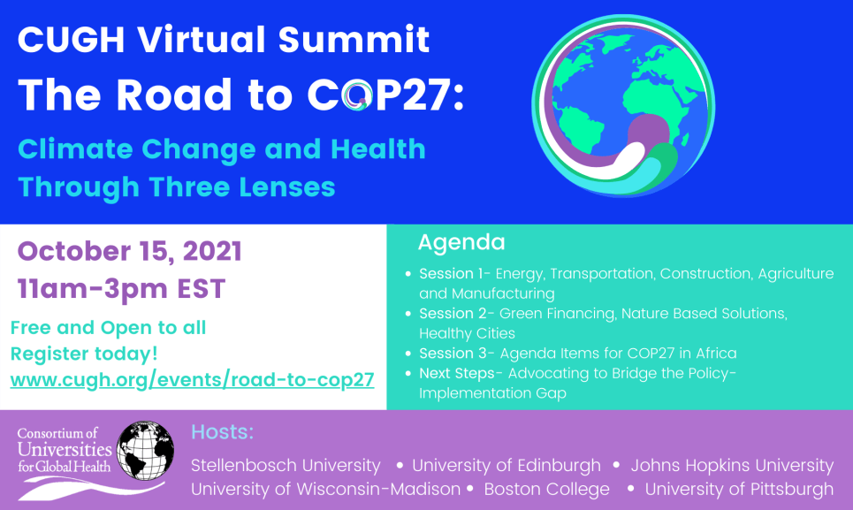

Slide 4
Breakout Panel Submissions
Deadline: August 31, 2021
Abstract Submissions
Deadline: September 23, 2021

Slide 6
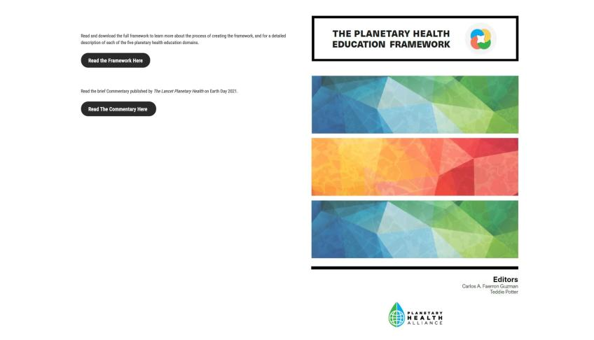
www.planetaryhealthalliance.org/education-framework

Slide 7
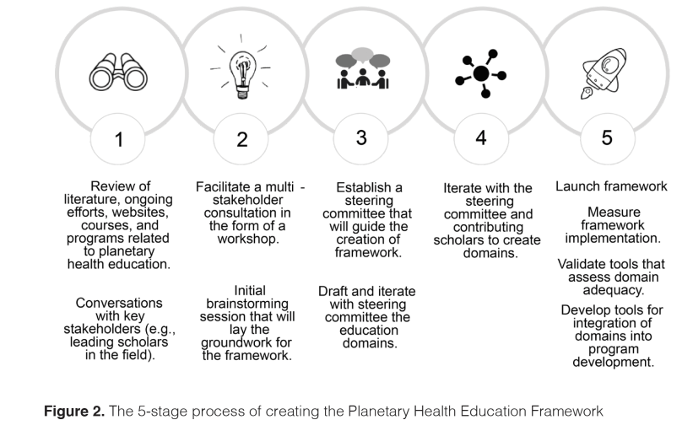

Slide 8
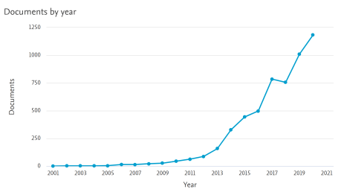
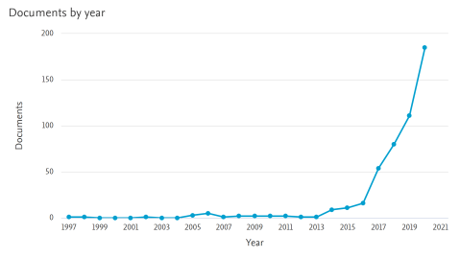
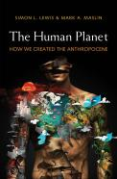
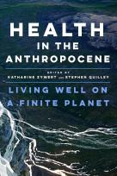
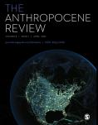
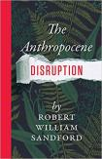
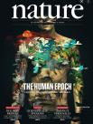

Slide 10
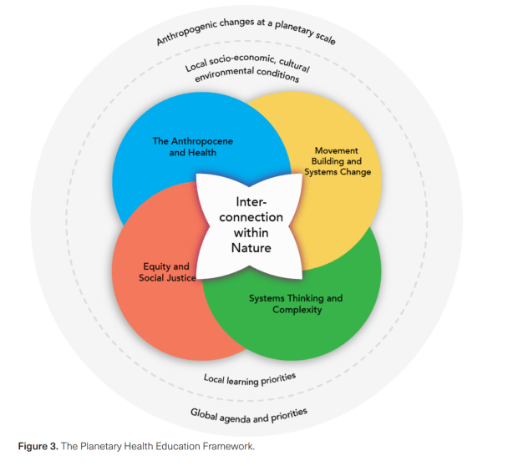

Slide 11
Interconnection Within Nature
Dr. Nicole Redvers, ND, MPH
Assistant Professor, Department of Family & Community Medicine
School of Medicine & Health Sciences
University of North Dakota
~Co-Founder/Board Chair-Arctic Indigenous Wellness Foundation

Slide 13
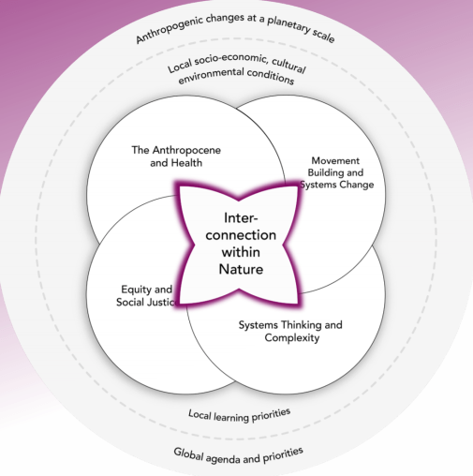
IWN
Understanding our role within Nature as a species and as individuals is foundational in Planetary Health science and practice.
Despite mounting evidence of our interdependence with the biosphere, our civilization's perspectives and consequential attitudes have not evolved accordingly.
The false sense of separation between humans and Nature perpetuates a deceptive culture of domination over Nature, inducing many current environmental crises.
(The Planetary Health Education Framework, 2021)

Slide 14
IWN
The IWN domain is centered in a continuation of similar frameworks described in the field of ecopsychology, environmental education, and related sustainability sciences, including:
-“human-nature connectedness”, "nature connectedness” “nature connection" "connectedness with nature", "connection to nature", or "nature relatedness" (Zylstra et al. 2014).
(The Planetary Health Education Framework, 2021)

Slide 15
IWN
In this domain, we refer to "interconnection" as an indicator for mutualism, reciprocity, and symbiosis.
We use the term "within" to denote that humans are part of and not separate from Nature.
We define the word "Nature" as encapsulating Earth and life (including humans).
(The Planetary Health Education Framework, 2021)

Slide 16
Stories
“The culture’s vitality is literally dependent on individuals, in community with the natural world. Indigenous cultures are an extension of the story of the natural community of a place and evolve according to ecological dynamics and natural relationships” (Cajete, 2018).

Slide 17
“Maya…cosmocentric worldview (CWV)—that is, a cosmology of conservation, or merged existence, where people, animals, plants, rivers, stones, clouds, etc., each played a role in maintaining the world.”
Ego (‘I’)
Eco (‘We’)
(Lucero and Cruz, 2020)

Slide 18
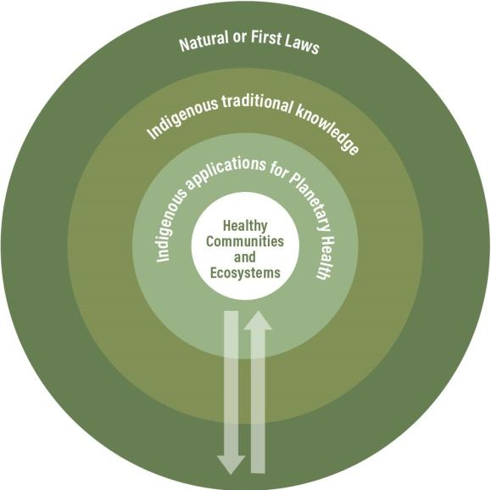
Earth Centered Jurisprudence
-Earth-centered jurisprudence systems govern both nature and global systems (i.e., there is a unity of natural laws between us).
-In the vision for a healthy future, it is important to create the conditions that enable the overcoming of the dissonance between ‘being in nature’ (i.e., nature that surrounds us) and ‘being of nature’ (i.e., nature that embodies us).
(Redvers et al, 2020a; Redvers et al., 2020b)

Slide 19
PH Educational Strategies

Slide 20
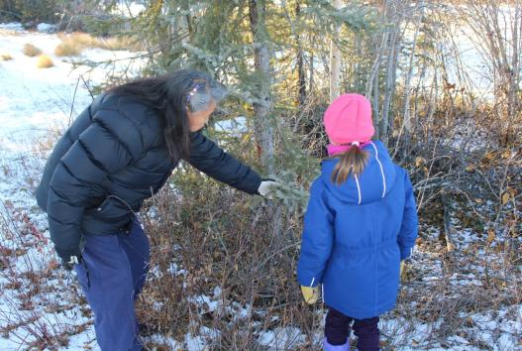
“Land-based is one of those words, it’s a beautiful, wonderful term. It is bringing people back to the land and helping them become alive and remembering their humanity and their connection to all living things. We are the land. So, if we remember who we are, then the same miracle that we see all around us, will be us.”
(Jennifer Redvers. (2020).“The land is a healer”: Perspectives on land-based healing from Indigenous practitioners in northern Canada.)

Slide 21
Mahsi cho (thank you) Twitter & Facebook: @DrNicoleRedvers

Slide 22
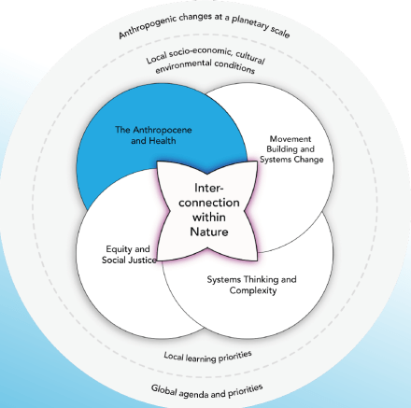
The Anthropocene and Health
“You cannot get through a single day without having an impact on the world around you. What you do makes a difference, and you have to decide what kind of a difference you want to make.”
A. Alonso Aguirre D.V.M., M.S. Ph.D
Professor and Chair, Department of Environmental Science and Policy
Chair of the Institutional Animal Use and Care Committee at George Mason University, Fairfax, Virginia.

Slide 23
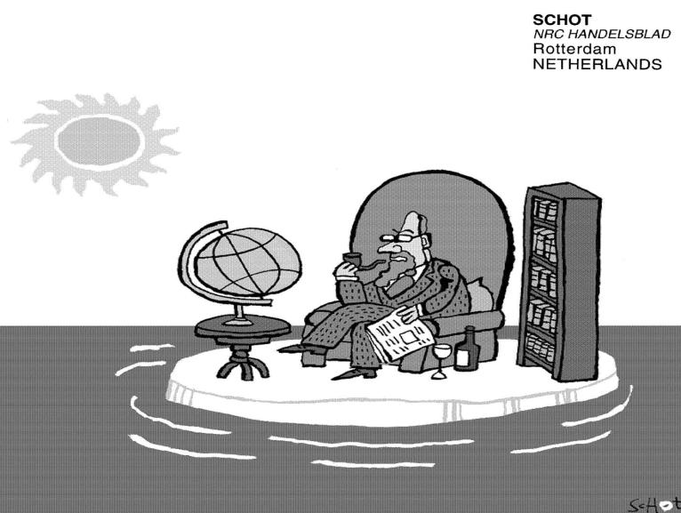
Dr. Planet

Slide 24
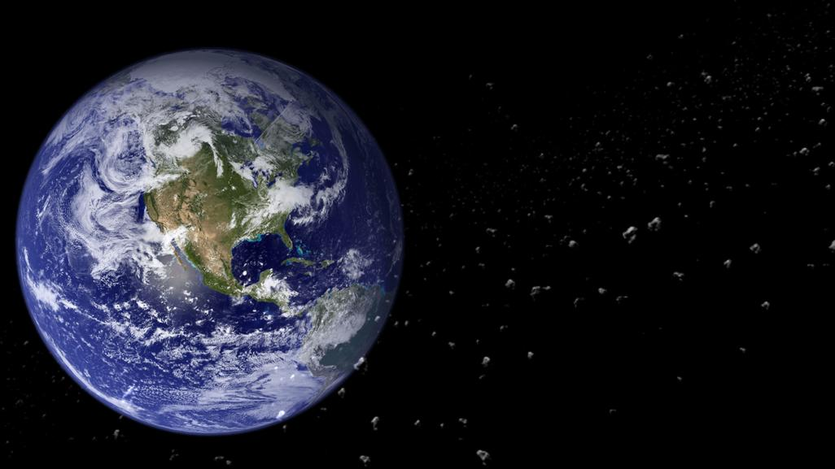
HEALTH CONNECTS ALL SPECIES IN THE PLANET
Just 19% of Earth’s land is still ‘wild’

Slide 25
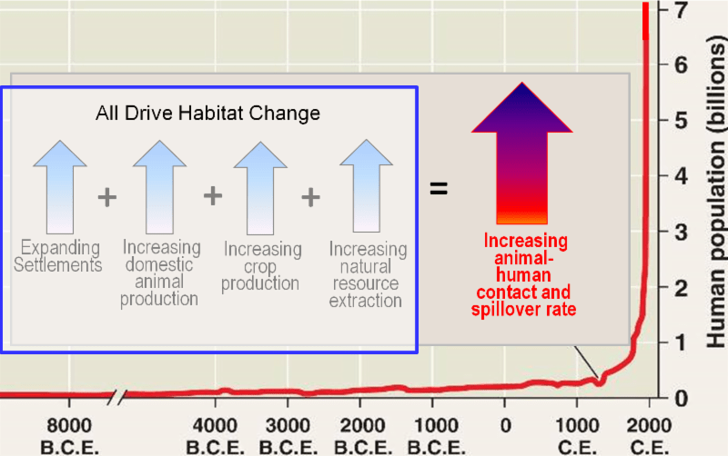
Doubled three times in the last three centuries
Since 1870, increased 7-fold & per capita GDP > 11 times
May reach 9.3 billion by the 2050
Improved health and technology have lowered death rates

Slide 26
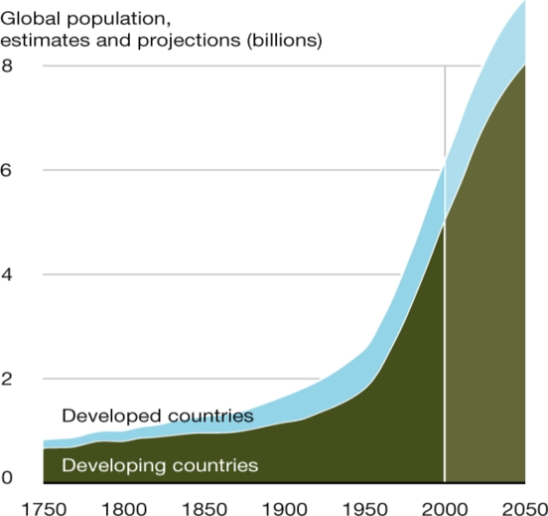
Ecological Footprint of 1 American = that of 43 Africans
http://foodenergywaternexus.org/2015/07/21/jason-clay-how-big-brands-can-save-biodiversity/

Slide 27
http://8020vision.com/

Slide 28
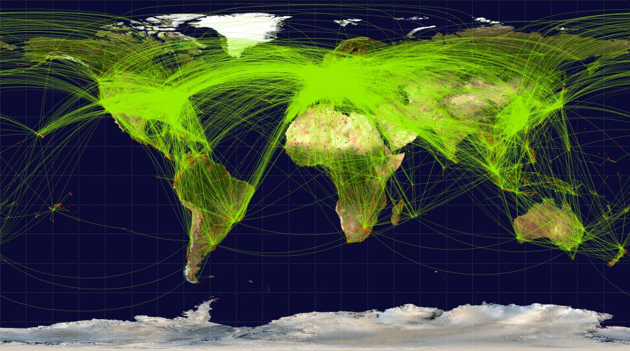
GitHub Routes, June 2014
Open Flights/Airline Route Mapper Route Database:
67663 routes between 3321 airports on 548 airlines spanning the globe

Slide 29
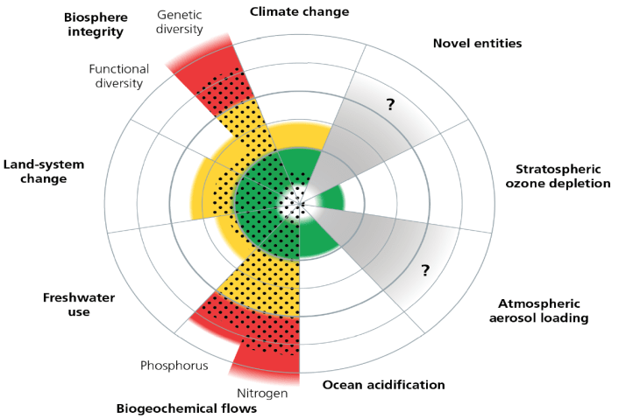
Planetary Boundaries
Steffen et al Science 2015

Slide 30
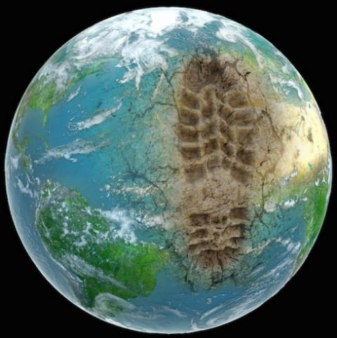
Anthropocene
Krutzen & Stoermer coined the word in 2000
A proposed geologic epoch in which the dominant force shaping Earth's biophysical conditions is human activity
Massive disruptions in earth system processes, climate stability, and ecosystems resulted from human activities
The Great Acceleration
newatlas.com

Slide 31
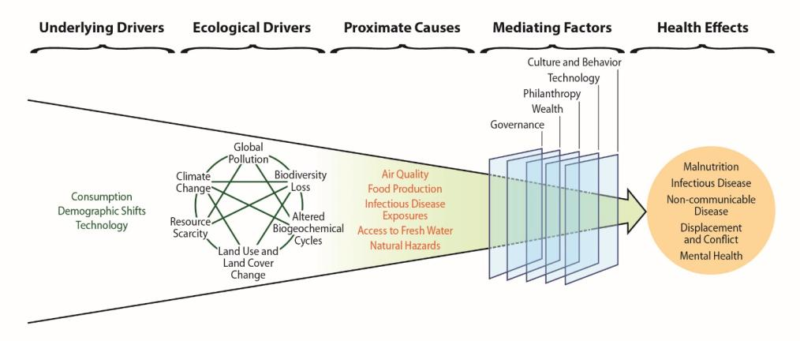
Fig 1.4 in
Schematic illustrating impacts of anthropogenic
change on human health.

Slide 32
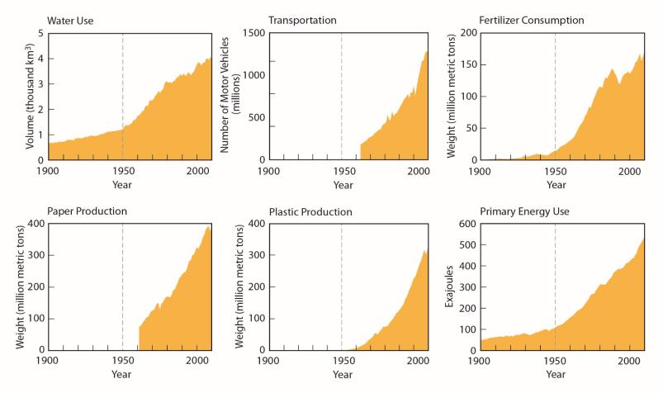
The Great Acceleration
Fig 1.2 in
Measures of consumption over time show dramatic increases since 1950

Slide 33
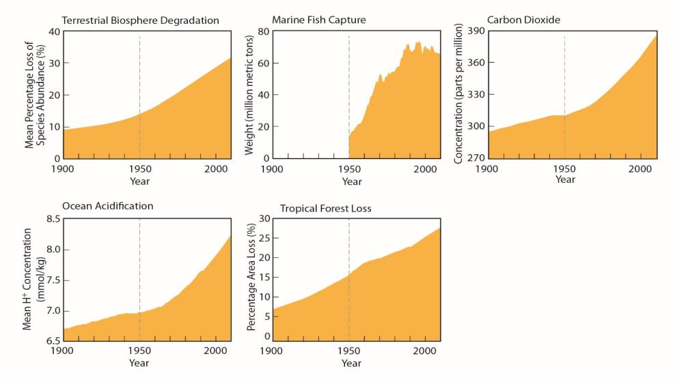
The Great Acceleration
Measures of human impact on natural systems show steep increases since 1950

Slide 34
“Three hundred trout are needed to support one man for a year. The trout, in turn, must consume 90,000 frogs, that must consume 27 million grasshoppers that live off of 1000 t of grass”
G. Tyler Miller, Jr. 1971

Slide 35
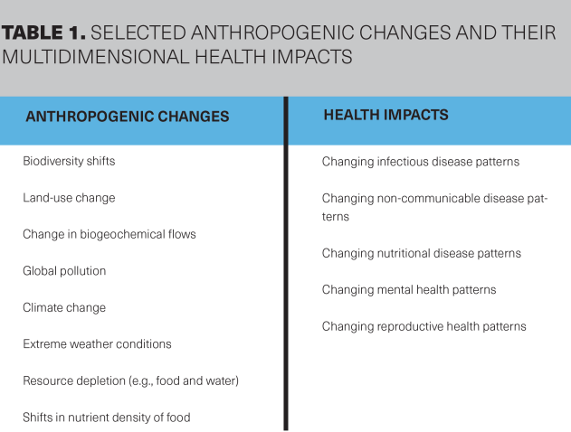

Slide 36
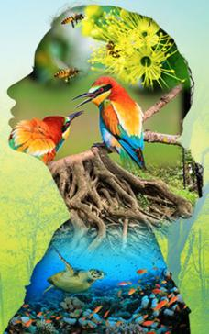
-Understanding of how specific anthropogenic impacts on Earth’s natural systems are connected to health outcomes.
-Uses a social and ecological approach to health promotion and disease prevention and control, ranging from individual to population-level determinants of human, animal, and ecosystem health.
-This domain also focuses on understanding the underlying and mediating factors that enhance or lessen health outcomes

Slide 37
The Anthropocene and Health: Key Concepts and Areas of Study
The social and environmental determinants of health
The Anthropocene and related concepts (e.g., capitalocene)
Anthropocentric and Ecocentric
Globalization
Demographic transition
Epidemiological transition
Planetary boundaries
Ecological footprint

Slide 38
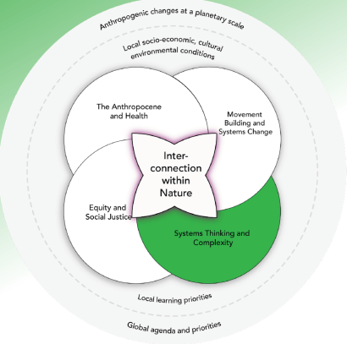
“Therefore, it is not only our ignorance, but also our knowledge that blinds us.”
—E. Morin
Carlos A. Faerron Guzmán, M.D., M.Sc
Associate Director, Planetary Health Alliance
Director of Global Health Programs
University of Maryland, Baltimore Graduate School
Notes:
Systems Thinking/complexity
The traditional and predominant approach to our ongoing challenges elicits a simple rule: to understand and solve a problem, the problem must be broken down into smaller and manageable pieces. Because of this, institutions created to "solve problems" now operate in silos, separate from each other and incapable of creating convergent solution-oriented routes. The latter is quite evident in the siloed nature of traditional higher education disciplines and the clear trends towards hyper-specialization (Sustainable Development Solutions Network 2020).
For planetary health, it is essential to take a step back and look at the whole picture. Because of this, Planetary Health builds and relies on approaches that incorporate system thinking (e.g., ecology). By doing so, planetary health attempts to analyze the interaction between elements within a system more than just describing the parts of the system itself. In this process, planetary health examines the interlinkages between human health and environmental health while considering how these interactions happen at different scales (geospatial and temporal) and how they respond to characteristics of complex adaptive systems (e.g., non-linearity, heterogeneous actors, emerging characteristics, self-organization, and feedback loops). In essence, in all of its components, planetary health requires transdisciplinary approaches to understand how human health and wellbeing emerge from the complex interactions between natural and social systems and address complex phenomena in favor of holistic solutions (Whitmee et al. 2015).
Where public health and global health discuss root causes of illness and disease, planetary health points to the upstream human behaviors that disrupt the planet’s natural systems and thereby disrupting human health for generations to come. In 2014, Richard Horton the Editor-in Chief of The Lancet, wrote, “The SDGs are fairy tales dressed in the bureaucratese of intergovernmental narcissism, adorned with the robes of multilateral paralysis and poisoned by the acid of nation state failure. Yet this is served up as our future” (p. 2196). Other criticisms of the SDGs include failure to address wealth disparities and overconsumption by a few.
Basically, the SDGs want to reduce inequality by ratcheting the poor up, but while leaving the wealth and power of the global 1 percent intact. They want the best of both worlds. They fail to accept that mass impoverishment is the product of extreme wealth accumulation and overconsumption by a few, which entails processes of enclosure, extraction, and exploitation along the way. You can’t solve the problem of poverty without challenging the pathologies of accumulation. (Hickel, 2015)
With a deep grasp of power dynamics and a core domain focused on equity and social justice, planetary health brings a critical awareness to the SDGs that is often missing in other models of health. Planetary health solutions work at the root cause of inequities and challenge the human behaviors at the source.

Slide 39
The field of planetary health draws upon approaches to systems thinking and describes how various elements interact and coalesce as part of complex systems
It is essential to characterize the linkages between environmental changes and human health at different geospatial and temporal scales
Doing so requires systems-based understandings that incorporate characteristics of complex adaptive systems
Learners work towards self-awareness to acknowledge their own biases and epistemological groundings.
Notes:
All my notes are here -

Slide 40
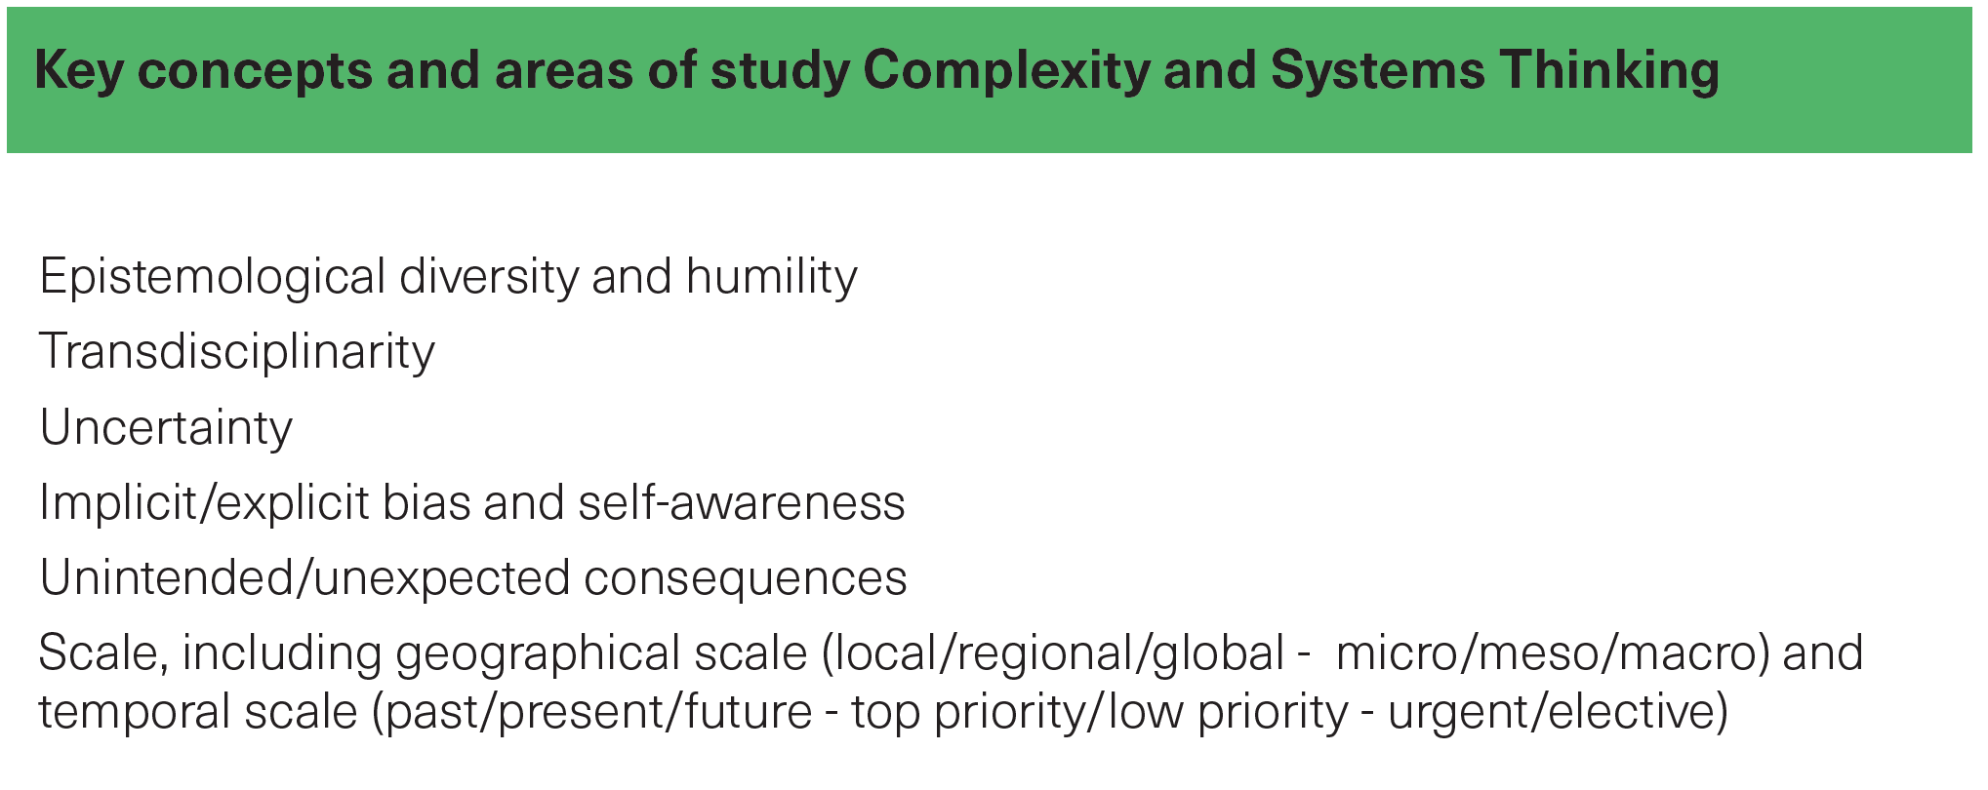

Slide 41
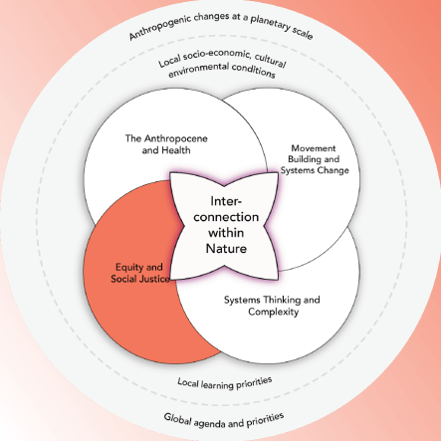
Barbara Astle, PhD, RN
Professor of Nursing, Director, MSN Program
Director, Centre of Equity & Global Engagement
Trinity Western University, Langley, British Columbia, Canada

Slide 42
Equity and justice in planetary health is founded on the rights of humans and the rights of nature, giving all human populations and ecosystems—present and future—the opportunity to attain their full vitality.
Realizing this requires eliminating systemic disparities so that no population carries disproportionate burdens of environmental and health impacts while others are able to thrive.
Education processes must acknowledge the structural inequities and how historical and political injustices have contributed to the disenfranchisement of populations and a degraded environment.
Future planetary health practitioners of the field must be able to rebuild the institutions (e.g., laws, health care, education) that promote and reproduce inequities and shape planetary living conditions.

Slide 43
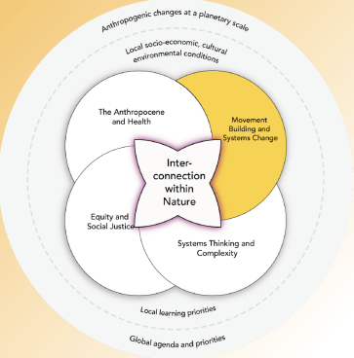
Effective movement-building is needed to solve the urgent planetary health crisis
Teddie Potter, PhD, RN, FAAN, FNAP
Director of Planetary Health
School of Nursing, University of Minnesota

Slide 44
Ideas may be inspiring,…
But to become
solutions,
they must
be put into action
Notes:
IMAGE Creative Commons License Photo by Nong Vang on Unsplash

Slide 45
Contrary to popular belief, movements do not simply emerge in response to a given moment. It may appear to some that shifts in social behavior can happen quite suddenly, when in fact, it usually takes immense behind-the-scenes visioning, network building, and strategizing.
Howard, C. (2020).Targeted change making for a healthy recovery. The Lancet: Planetary Health, 4(9), e372-374.
Notes:
IMAGE: Public Domain, Library of Congress
1955 but Secretary of the NAACP before that and “tired not from working but tired of Jim Crow segregation”
Parks was not the first Black woman to refuse to give up her bus seat for a white person—15-year-old Claudette Colvin had been arrested for the same offense nine months earlier, and dozens of other Black women had preceded them in the history of segregated public transit. However, as secretary of the local NAACP, and with the Montgomery Improvement Association behind her, Parks had access to resources and publicity that those other women had not had. It was her case that forced the city of Montgomery to desegregate city buses permanently.

Slide 46
Movements require inclusive relationships
Notes:
IMAGE: Ecola State park, Cannon Beach, Oregon, USA. Published on June 16, 2019. Free to use under the Unsplash License

Slide 47
Movements require thoughtful strategy
Notes:
Photo by JESHOOTS.COM on Unsplash Creative Commons license

Slide 48
Movements require effective communication
Notes:
IMAGE: Photo by ROBIN WORRALL on Unsplash Creative Commons License

Slide 49
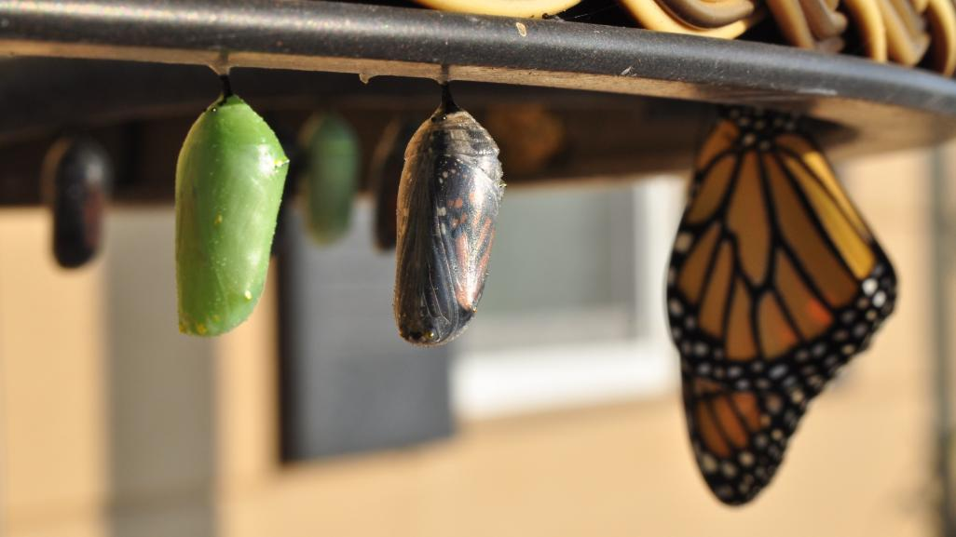
Movements require transformational partnerships
Notes:
IMAGE: Photo by Cytonn Photography on Unsplash Creative Commons license

Slide 50
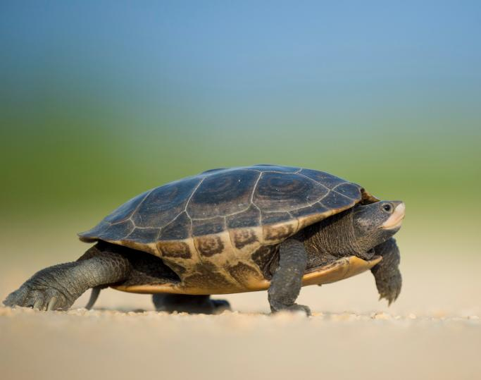
Go slow to move fast
Notes:
IMAGE: Photo by Ray Hennessy on Unsplash

Slide 51
Final Thoughts…
Current moment of impasse
We risk losing all of our progress
Urgency
Hope
“However, we cannot achieve the change needed without a profound shift in our education system.

