Slide 1
Building Effective Partnerships for Development Between Low-Income Countries: a powerful opportunity for impact.
The African landscape through the eyes of Uganda.
Partnership Progression over the years
Harriet Mayanja-Kizza, Makerere University
June 26, 2023
10:00am-11:00am EST,
17:00 – 18:00 pm EAT

Slide 2
Every Cloud has a silver lining
Pre HIV era – medical training in Africa – was primarily “in house”
  supplemented by available international textbooks,
  occasional ad hoc visiting lecturers and residents
  irregular hard copy journal editions in the libraries
Along came - HIV pandemic - impacted on the global community - and realization of a need for joint training and research efforts - to improve health – globally.

Slide 3
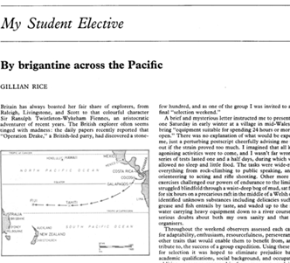
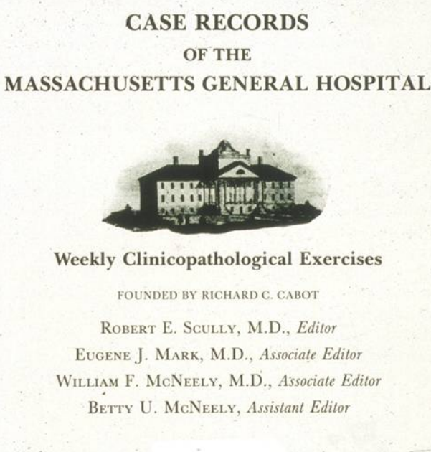
Pre HIV - In library “Global Health Education”
My student elective. With the people of Hiranpur. Th BMJ. Meakins SJ: Feb 1980
Case records of the Mass General Hospital. Weekly clinicpathological exercises.
Case 18-1982. A 47-yr old man with fever and a mediastinal mass. N Engl J Med. 1982 May 6;306(18):1096-102.

Slide 4
The new disease – c1981
The Global Response – changed the landscape
Serwadda D, Mugerwa RD, Sewankambo NK, et al Slim disease: a new disease in Uganda and its association with HTLV-III infection. Lancet. 1985:849.
Fogarty International Center (FIC) at NIH
AIDS International Training and Research Program (AITRP) 1988 - 2012
Uganda: c.100 - Phd, MSc, Short courses
Epid. & Biostat, Microbiology, Immunology, Behavioral sciences, Pead HIV impact, Lab. Techs, Research clinicians and Admin
c.95% back in Uganda
Case Western Reserve University – Makerere University
1986 Frederick C. Robbins, Nobel Laureate came to Uganda

Slide 5
Next…South-South-North Global research & training
NACCAP 2004-2009 – HIV In country training Uganda, Rwanda, Netherlands, Masters, Doctorate
Uganda, 2003, Infectious Disease Institute (IDI), - 9 Ugandan, 5 American HIV researchers.
Trained across Africa, ID fellows from the USA.
Later founded the West Africa IDI (WAIDI) – a West African hub in “Capacity Building, Research and Innovation”
BMGF - 2005, EDCTP 2010 - studies –Uganda, Gambia, Namibia, Malawi, South Africa, Germany , USA. Tuberculosis Immuno-diagnosis
IDRC, NIH (ICEMR_PRISIM) - 2007 - Malaria – Trained Ugandans – Masters, Doctorate, Short courses Uganda, USA, UK

Slide 6
Next…South-South-North Global research & training
SANTHE-BMGF, Deltas Africa – 2022. (Developing Excellence in Leadership, Training, and Science in Africa). South Africa, Uganda, Kenya, Rwanda, Cameroon, Botswana, Zambia – US, Europe partners. HIV and tuberculosis control. Doctorate, Post Doc, Masters.
CEBHA plus-BMBF (Germany) – 2016-2022. Evidence synthesis: Uganda lead, Ethiopia, Rwanda, Malawi, South Africa, Germany : Diabetes mellitus, hypertension, road traffic injury prevention strategies. Masters, Doctorate, Short courses EBHC&PH
CDC Africa

Slide 7
High Impact on LMIC Research, & Research Training
LMIC have discovered each other - including awareness of their:
  Strengths
  Weaknesses
  Opportunities
  Limitations
LMIC now taking lead in some of these LMIC-LMIC –HIC research and training programs - with increased face to face interaction in LMIC
LMIC improved putting emphasis on health and training issues with a focus on LMIC settings

Slide 8
Impact on LMIC-LMIC Global Health Education
Still seems to lag behind
Uganda – annually, about 20 medical students →4-6 weeks in USA and Europe medical schools - but limited LMIC-LMIC exchanges.
Also, about 10-15 faculty short visits to HIC medical schools.

Slide 9
International Training Initiatives
Bellagio Global Health Education Initiative (BGHEI) 2016 - forum for debate and discussion on universal global health education.
Uganda, Tanzania, South Africa, Israel, India, China, Colombia, USA, UK – 2022 meeting in Uganda.
Sub-saharan african network for TB/HIV research excellence (SANTHE) 2021. Advance African Science – Research& Training.
South Africa, Uganda, Kenya, Zambia, Zimbabwe, Cameroon

Slide 10
Funding Issues →
HIC – partners, sub awards – encourage LMIC-LMIC research teams
LMIC – direct recipient of HIC research and training grants
What of LMIC funding options and opportunities??
  Africa Union and CDC Africa – often through various HIC organisations
In the current Financial Year (2022/23), Makerere University expects to receive about 30 Billion Uganda shillings (about US$ 8.1 million) under the Government Research and Innovation Fund (RIF) – 4th year.
University Of Dar es Salaam 5th call for proposals for competitive research and innovation grants for year 2022-2023 TZS 3,155,000,000/= (about USD 1,309,000)
African Union Research Grants (AURG)
The AURG supports pan African research and development through grants and direct funding, provided by the Pan-African Programme.

