Slide 1
Partnership between Low and Low-medium income countries to boost health systems
Ximena P. Garzon-Villalba MD, PhD, CPH

Slide 2
What do we have in common?
Political instability
Lack of funding
Unstructured health systems
Week epidemiological surveillance systems
Need of well-trained human resources
Laboratory capacity (all levels)
Response capacity and preparedness

Slide 3
What are the strengths of each country/region?
What are the weakness of each country/region?

Slide 4
What
What positive or negative lesson learnings could we share?

Slide 5
What
Public Health can´t keep being approached in silos

Slide 6
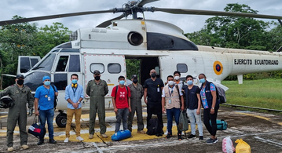
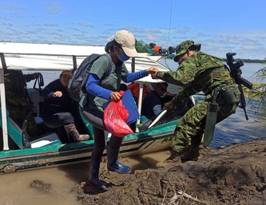
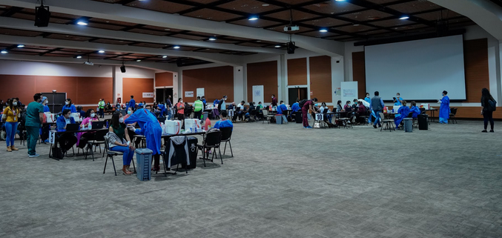
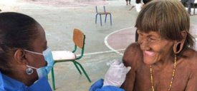
Thoughts?
Notes:
¿

