Slide 1

Healthcare Information For All (HIFA)
A community of practice on how to improve the availability and use of reliable healthcare information
Neil Pakenham-Walsh, HIFA Coordinator
CUGH meeting, 14 September 2023

Slide 2
Why HIFA is needed
  8M deaths per year in LMICs are due to poor quality care
  Failure to access and apply reliable healthcare information is a major cause of avoidable death and suffering
  Parents, families and patients lack access
  Health workers lack access too
  This contributes to poor quality care at all levels (self-care, family care, primary care, hospital care)

Slide 3
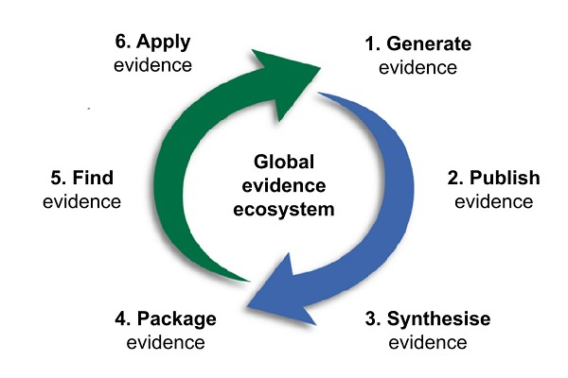
Why are people dying for lack of reliable healthcare information? Failure of global evidence ecosystem

Slide 4
Why is the system failing?
  Three systemic weaknesses
  Poor communication among stakeholders
  Poor understanding of information needs and how to meet them
  Poor advocacy for the goal of universal access to reliable healthcare information
  HIFA aims to address these three weaknesses

Slide 5
HIFA strengthens communication
(among all stakeholders in the system)
…
…
…
…
…
…
20,000 members, 180 countries, interacting in 4 languages

Slide 6
HIFA strengthens understanding (of information needs and how to meet them)
  1. Spontaneous discussions
  Example: JMIR Infodemiology 2022: Qualitative Analysis of the COVID-19 Discussion on the Multidisciplinary Healthcare Information for All Health Forum
  2. Planned discussions
  Example: Oxford Open Digital Health 2023: Using an online community of practice to explore the informal use of mobile phones by health workers
  3. HIFA Voices database
  Database of experiential knowledge shared on HIFA forums (prototype)
Notes:
1. 865 posts from 246 participants
Mutual understanding
Social media, lack of trust in governments, inconsistent messaging
WHO: Maintaining essential health services
2. Helped develop a definition of mobile phone use

Slide 7



HIFA strengthens advocacy for universal access:
Bringing >400 organisations together in support of universal access
Notes:
More than 400 health and development organisations have officially declared their support for the HIFA vision:
a world where every person will have access to the healthcare information they need to protect their health and the health of others, and will be protected from misinformation.

Slide 8

HIFA strengthens advocacy for universal access:
Advocating for high-level commitment (1/2): professional bodies

Slide 9
HIFA strengthens advocacy for universal access:
Advocating for high-level commitment (2/2): WHO
We believe WHO is ready to commit explicitly to universal access
1948: WHO Constitution: “The extension to all peoples of the benefits of medical… knowledge is essential to health” (1948)
2022: HIFA enters into official relations with WHO
2023: WHO Deputy DG: “Universal health information is essential for UHC”
When WHO commits to universal access, this will be a game-changer
To make this happen, we need a catalyst…

Slide 10

The catalyst: Your voice
We need your voice. Complete the survey today! Spread the word!
www.hifa.org/survey2023

Slide 11











Thank you to survey supporters
Financial support:
Technical support:
Complimentary publicity:
Your organization?
Notes:
The stakeholder consultation is costing HIFA US$12k. To date we have raised US$5k with thanks to the above organisations and personal donations. We urgently need further support to continue our work.
Please help by donating through our dedicated fundraising page:
https://hifa.online-donation.co.uk/consultation
Your support will be publicly recognised in our communications, website, presentations, final report, and publications.

Slide 12
What you can do:
Complete the survey: www.hifa.org/survey2023
Join HIFA: www.hifa.org/join
Contact: neil@hifa.org
Thank you!

