Slide 1
Australian Leads:
University of Canberra(UC),
School of Medicine & Psychology, Australian National University(ANU-SMP),
International Partner:
Indian Institute of Public Health Gandhinagar
CUGH Presentation
14th Sept 2023
I-PELICAN
International Peer Exchange and Learning Innovation-Canberra University
Presenters:
Danish Ahmad(ANU-SMP) & Ro McFarlane(UC)
On behalf of the I-PELICAN Team
UC:, Jennifer Smith
IIPH-G: Deepak Saxena, Dr Dileep Mavalankar

Slide 2
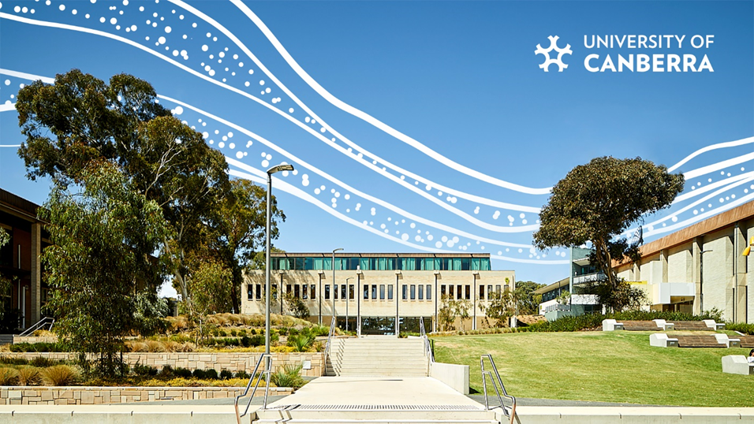
Australian Custom ‘Acknowledgment of Country’
The University of Canberra and Australian National University acknowledge the Ngunnawal people, traditional custodians of the lands where our campuses in Canberra are situated.
I wish to acknowledge and respect their continuing culture and the contribution they make to the life of Canberra and the region.
I also acknowledge all other First Nations Peoples on whose land we gather.

Slide 3
Genesis
2023
2022
2021

Slide 4
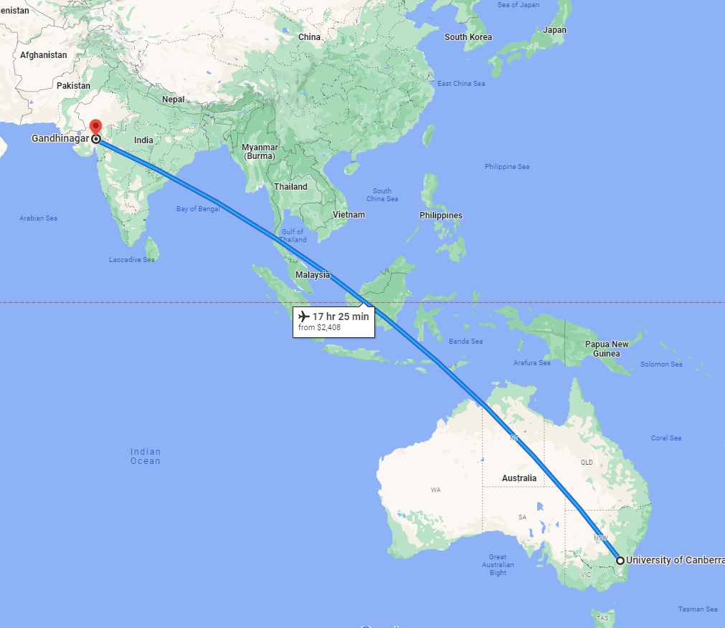
Key participating Institutions
Indian Institute of Public Health-Gandhinagar
https://iiphg.edu.in/
India’s first Public Health University
Located in Gandhinagar- Gujarat’s State Capital
Gandhinagar pop: 414,438
University of Canberra(UC)
https://www.canberra.edu.au/
Public University(#2 in Australia –THE Young University)
Located in Canberra- Australia’s Capital City CBR pop: 462,000

Slide 5
What was done? I-PELICAN
In 2022 (August-Sept), ANU-SMP, UC public health team, and a UC education designer jointly ‘designed –implemented-evaluated-published’ as a ‘proof of concept’, the I-PELICAN initiative:
Demonstrated the implementation feasibility of a virtual practice-based module to supplement classroom teaching
Low-cost, sustainable approach promotes flexible and multidisciplinary adoption by other course streams and universities, allowing for real-time online student exchange and learning.
Low cost as it was embedded in an existing unit, replaced traditional tutorials used institutional software (Zoom/Poll Ev/Google) and we paid about 180$ in all across Padlet/Canva

Slide 6
I-PELICAN session plans
- Tutorial dates and times matched with the partnering Indian host university in advance.
Online Technology used: Zoom and Padlet (paid) – already familiar technologies.
Approx 10 hours total-2 hours per weekly tutorial
 | Pilot Tutorial | Tutorial#1 |  | Tutorial#2 | Tutorial#3
Tutorial Theme | completed | Understanding India and Australia’s COVID journey
Tutorial Focus | Orientation | New Knowledge Development | Skill Development | Skill Development | Applied Focus
Learning aims | Welcome, introduction and refinement | Develop an understanding of how cultural and societal factors influence the perception of healthcare-seeking attitudes in an Indian and Australian context. | Learn about analytical frameworks for systematically approaching contemporary public health issues in an international context. | Learn about analytical frameworks for systematically approaching contemporary public health issues in an international context. | Apply theory and real-life experience to develop a health system intervention to address a contemporary global health challenge

Slide 7
Example of an individual tutorial session plan in Zoom
Main Room | Break Out Room | Main Room
15 Minutes(recorded) | 30 Minutes (Unrecorded) | 40 Minutes (recorded)
Facilitator’s Discuss Framework and Global health Case study. Supported modelling of professional and intercultural behaviours | Student group activity on cross cultural learning using peer generated photo’s | Students Reflection, Wrap up and Evaluation

Slide 8
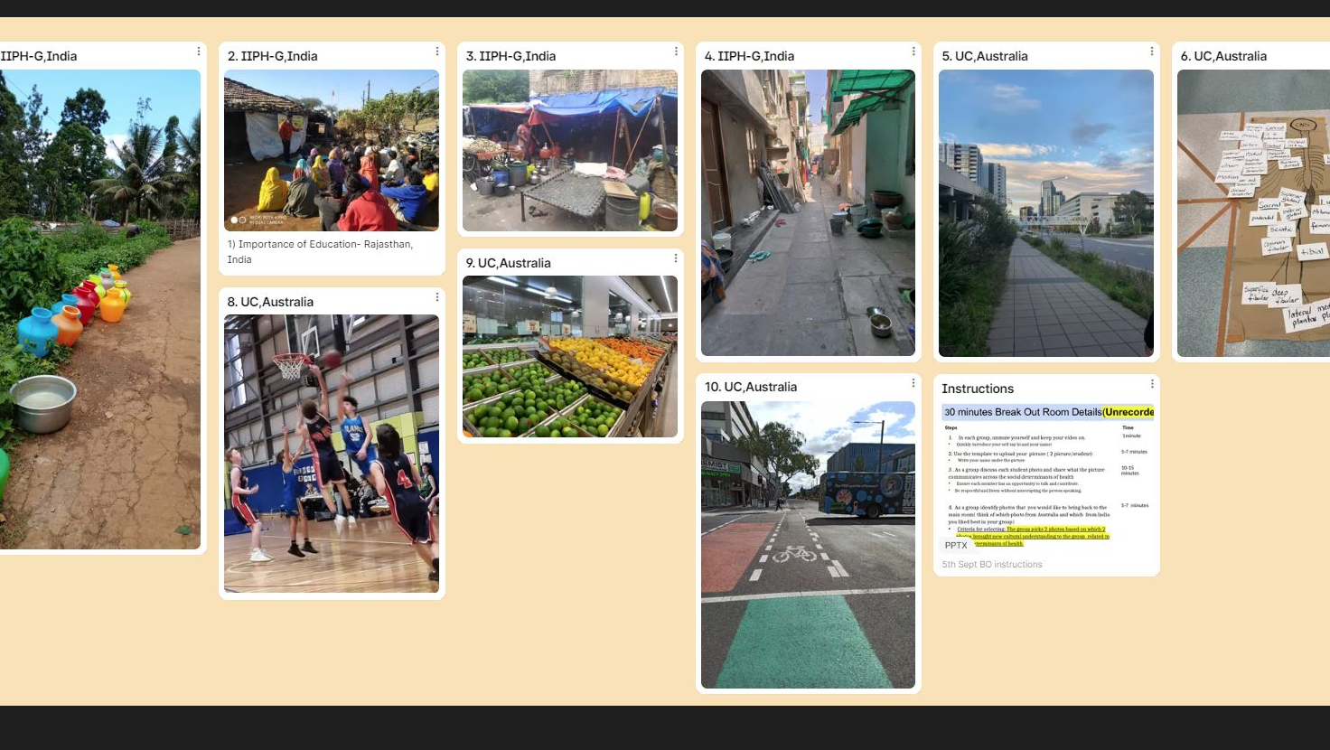

Slide 9
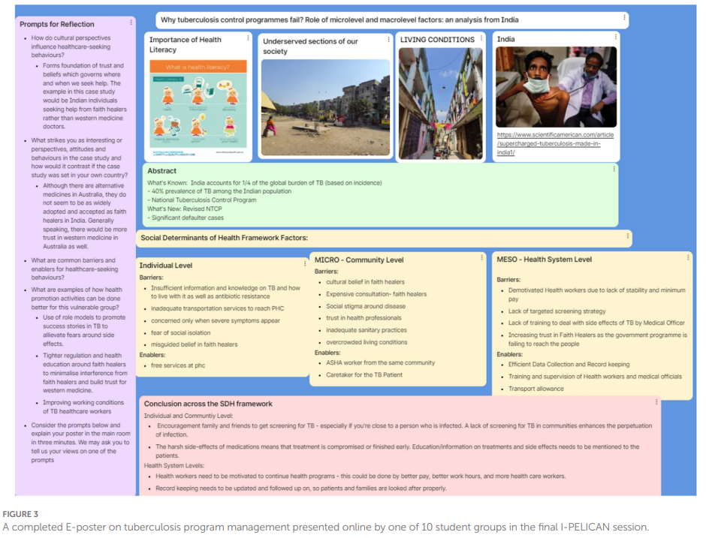

Slide 10
Outcomes
Domestic/Bilateral (UC-ANU-SMP) Institutional Ties Strengthened
International/Trilateral (ANU-SMP-UC –IIPHG) Collab
Staff Training and Capacity Building
Student Engagement, International Cultural & Health System Exposure and Virtual Mobility
I-PELICAN-Academic Metrics
UC University Excellence Award 2022
Curriculum and Pedagogy Publication
Case Study HE Fellowship
Advance HE innovation case study submission
2023 UC is extending I-PELICAN
2024 ANU-SMP? introduces I-PELICAN
Picture: Shutterstock

Slide 11
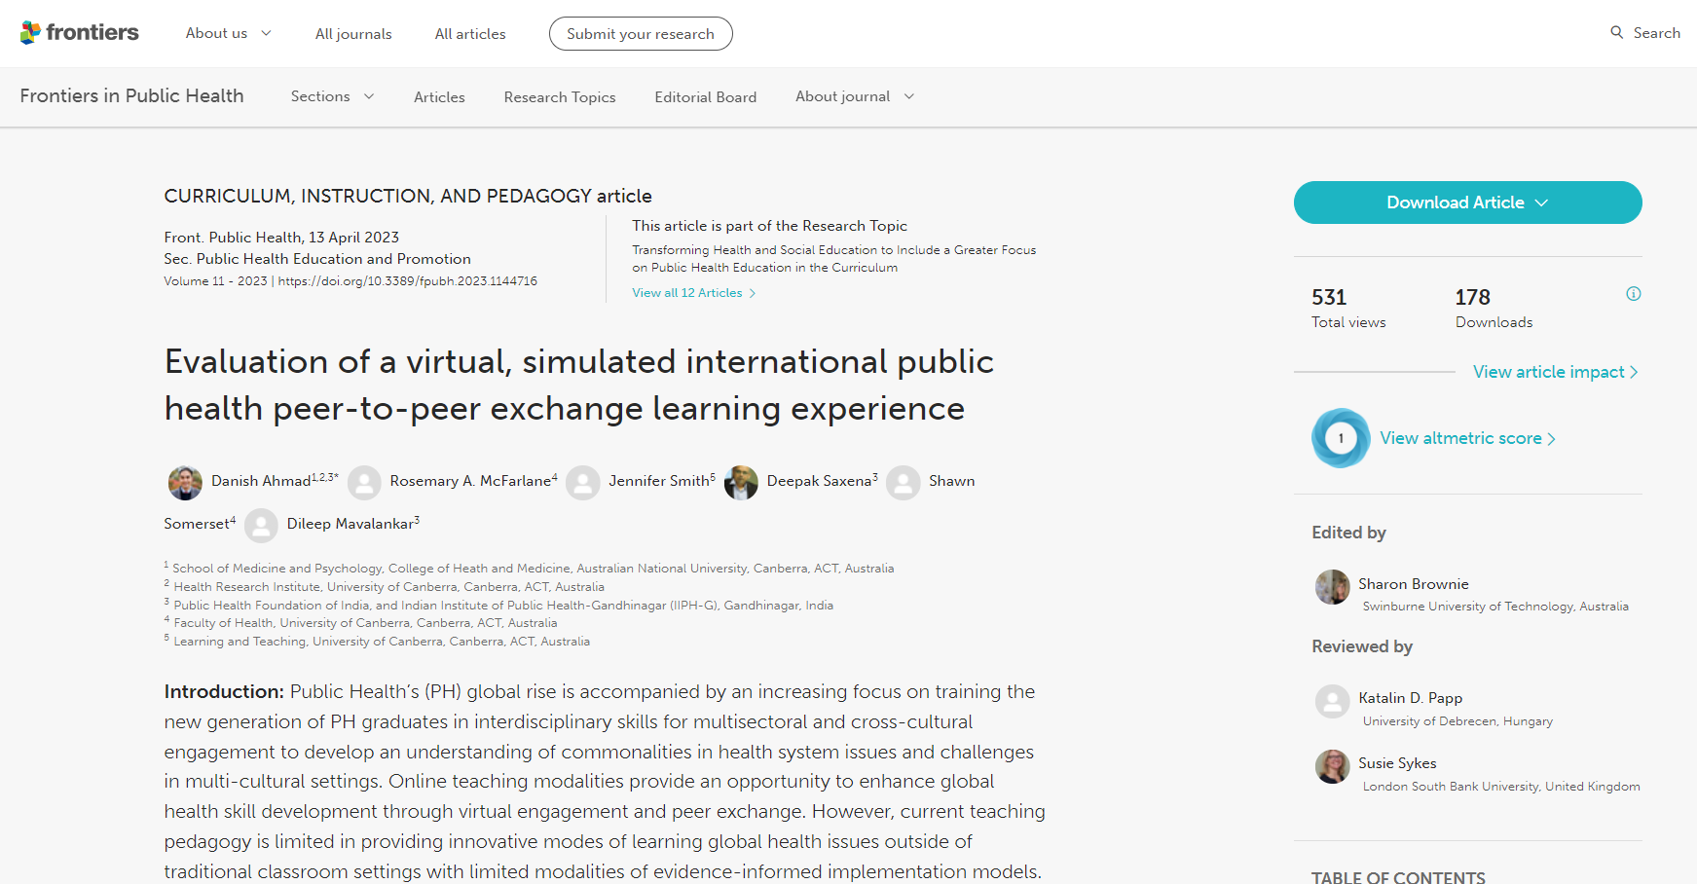
How was I-PELICAN conducted: Frontiers article
https://www.frontiersin.org/articles/10.3389/fpubh.2023.1144716/full

Slide 12
Institutions & Collaborators: Welcomed to Join the I-PELICAN 2024 journey.
Institution Topic | Matching | Partnering Institution
Email us for queries, feedback and collaborations
Danish (ANU-SMP): Danish.ahamd@anu.edu.au
Ro McFarlane(UC) :Ro.McFarlane@canberra.edu.au
Thank you. International Peer Exchange and Learning Innovation-Canberra University

