Slide 1
Introduction to COIL
Collaborative Online International Learning
The Intersection of Global Education and Student Empowerment
Hope Windle
Director, SUNY COIL Center
coil.suny.edu
coilinfo@suny.edu
COIL is Resistance.

Slide 2
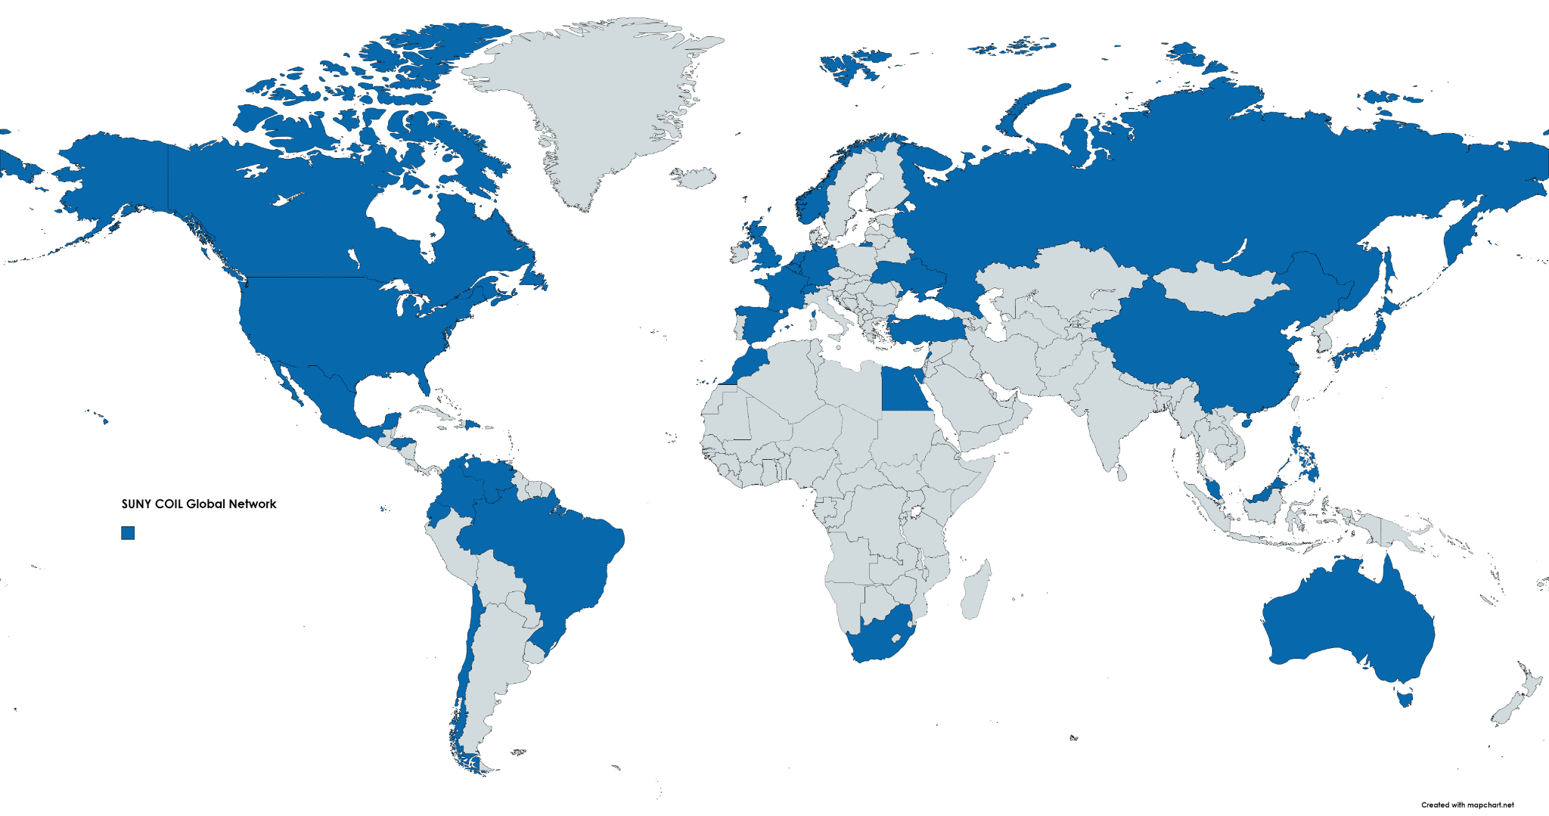
SUNY COIL
Global Network 2006-now
this year
157 institutions
61,200 students
28 countries
6 continents
Just added institutions in Romania and Kazakhstan!
https://coil.suny.edu/global-network/
Notes:
The SUNY COIL Center and Virtual is 20 years old. This approach to learning is here to stay.

Slide 3
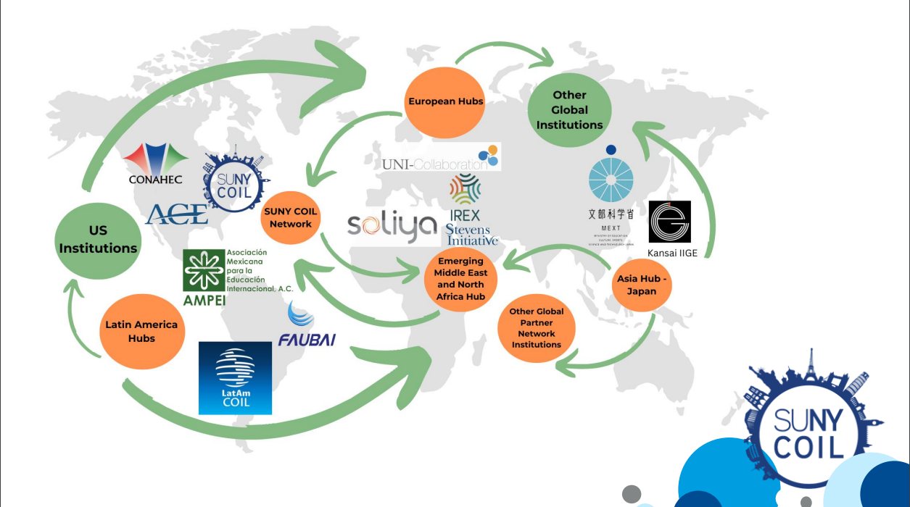
SUNY COIL CENTER 2022 Collaborative partner for strategy, training, research and leadership

Slide 4
Who Knows What COIL Is?
Collaborative Online International Learning
thumbs up and or share in the chat!
Notes:
Hello everyone, I’m Hope Windle, Director of the SUNY COIL Center. SO Happy to be here today r
is as a white middle class protestant woman,
and will be brief to share about COIL and historically how we have created opportunities for professors and students
am really looking forward to hearing from everyone today.
Love

Slide 5
Define learning outcomes
Determine the length of interaction
Design comparative and collaborative activities
Select methodology and technology
Monitor student work and learning
Assess and evaluate student outcomes
*Develop an effective international team
*Discuss issues, course content
*Problem solve
*Create a project-based assignment as part of their coursework
COIL is about connecting across differences.
Professors and students work with their peers in an online learning environment to explore subjects, themes, issues, and ideas

Slide 6
COIL is customizable approaches.. fit your needs and course content
Pre-
College
EOP +
COIL
First Year +
COIL
COIL within
your 15 week course
COIL
pre post with Travel
Course
COIL
with
Your Research
COIL Project with Client/ NGO
COIL Project focused on UN SDGs
COIL to check off
Intercultural Applied Learning for National Accreditation.
2-3 weeks
3-4 weeks
4-6 weeks
3-6 weeks
4-6 weeks
5-10 weeks
4-6 weeks
Think of a course where your students would benefit from doing a project with students from somewhere else in the world
Types of COIL Collaborations
Notes:
The team building phase includes introductions and icebreakers, along with discussions and activities designed to help students get to know and feel comfortable working with one another online and across cultures.
The discussion phase includes comparative discussions and organizing the project that teams of students will be working on. This phase continues to build student teams, but focuses the work on the course topics to prepare students for effective collaborative project work.
The project phase is the main activity for the collaboration. This is the time that students apply their knowledge, create something together or have substantive discussions around the topic of the collaboration.
The concluding phase includes presentation of work completed, in any format agreed upon by the collaborating professors, final reflections, and concluding.

Slide 7
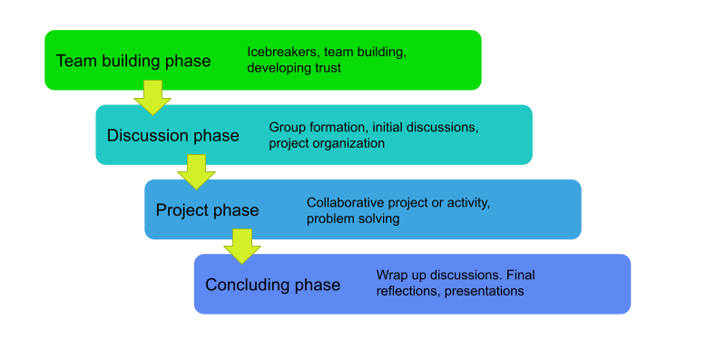
Typically 5-10 week collaboration
Works even with 2 weeks - Icebreaker and Discussion
Facilitated by the
partnered professors
padlet
Flow and Tools of a COIL Collaboration
Notes:
The team building phase includes introductions and icebreakers, along with discussions and activities designed to help students get to know and feel comfortable working with one another online and across cultures.
The discussion phase includes comparative discussions and organizing the project that teams of students will be working on. This phase continues to build student teams, but focuses the work on the course topics to prepare students for effective collaborative project work.
The project phase is the main activity for the collaboration. This is the time that students apply their knowledge, create something together or have substantive discussions around the topic of the collaboration.
The concluding phase includes presentation of work completed, in any format agreed upon by the collaborating professors, final reflections, and concluding.

Slide 8
What is Virtual Exchange?
Dialogues and collaboration between people and classrooms sustained over a period of time online
Interactive social learning
Facilitated (by professors or trained facilitators)
Meaningful intercultural experiences
Intentional, goal-oriented activities
Often project-based, can involve service learning and/or community engagement

Slide 9
What Virtual Exchange is not…
Virtual mobility
Digital Penpals
International guest lectures
Distance learning courses
MOOCs
Informal social media interactions
“Study Abroad Lite”
Unplanned, unstructured

Slide 10
Global Health Oriented COILs
Green Dentistry Fulbright research between Durban University of Technology South Africa
UNESP, Sao Paolo State University, Brazil and New York
Solutions to Food Insecurity, and Chronic Disease
Venezuela, Yemen, New York
Working with local Community Parks organizations in Kenya, Venezuala
Nursing Students learning about SDGs and each other
Violence against Women Awareness campaigns - Colombia, South Africa, Mexico
Articles of COIL examples https://bit.ly/publishcoil

Slide 11
Medical / Global Health Oriented COILs
Green Dentistry research between Durban University of Technology South Africa
UNESP, Sao Paolo State University, Brazil and New York
Solutions to Food Insecurity, and Chronic Disease
Venezuela, Yemen, New York
Working with local Community Parks organizations in Kenya, Venezuala
Violence against Women Awareness campaigns - Colombia, South Africa, Mexico
Nursing Students learning about SDGs and each other
Articles of COIL examples https://bit.ly/publishcoil
Notes:
https://docs.google.com/document/d/1hLOW0IXSxUCnfrvzKAqWbU9NlbNWG2mY/edit
https://docs.google.com/document/d/1F6towV5iDk70QNECV8YWm9ECJqFPfquS0-1b0lawolg/edit
https://docs.google.com/presentation/d/1cB0GTWyo9JqWgd3YiTWbdpji60GgAlKD/edit#slide=id.g1fa0dfd4fd7_0_1
https://docs.google.com/document/d/1F6towV5iDk70QNECV8YWm9ECJqFPfquS0-1b0lawolg/edit
Tackling complex twenty-first century global health challenges requires crossdisciplinary collaborations that extend beyond physical classrooms and across continents. The Transdisciplinary Education and Community Health Collaboratory (TEaCH CoLab) is a global teaching co-op established by health promotion and humanities faculty at three universities (Waterford Institute of Technology and the Institute of Technology, Carlow in Ireland, and the University of Washington, Bothell in the U.S.). The primary goals of TEaCH CoLab are to enhance global learning and problem-solving among the next generation of community and public health practitioners, to improve public health teaching (with a focus on digital pedagogy), and to increase empathy and community-connectedness. In this descriptive article, we present our program model and lessons learned from the first three years of collaboration to provide insights into how such capacity-building projects are established and sustained over time and across diverse geographical, cultural and temporal landscapes. Collaboration happens primarily online through academic and community partnerships, collaborative online learning, and pedagogy discussion and development. Students get to engage with course content and experiential learning that is part of a shared, global curriculum which emphasizes social justice, health equity, cultural humility and anti-racism, and advocacy. Our “lessons for the field” are collective, practice-based reflections by members of TEaCH CoLab based on their experiences and their involvement in development and facilitation. Our model for learning may help other health promotion scholars and practitioners develop meaningful global learning experiences that strengthen the interconnectedness of praxis, pedagogy, and communities.

Slide 12
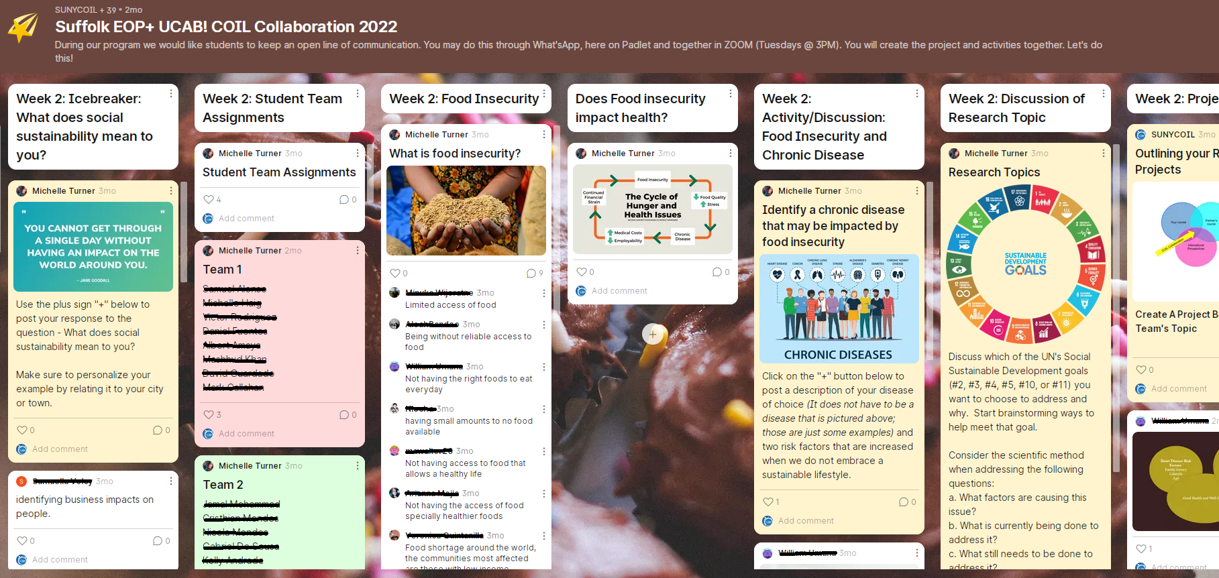
What are your Disruptive Practices for Global Learning?
“We need to focus on building and rebuilding rooms, not on regulating traffic within and between them. This is a world-making project aimed at building and rebuilding actual structures of social connection and movement, not mere critique of the ones we already have (Taiwo 2022).” This is what COIL can do.
Notes:
how it would work practically… do we provide Internet access or computers or devices? No. we meet them where they are… knowing people are connected by their phone and whatsApp. Make that work for the team conversation as well as projects together, working hands on in and out of the classroom
Develop some questions for the audience to participate:
What are ways you can be disruptive in your practices for global learning?
Share a time when you felt complicit in the reproduction of inequality and what you would do differently?

Slide 13
Perspectives on COIL

Slide 14
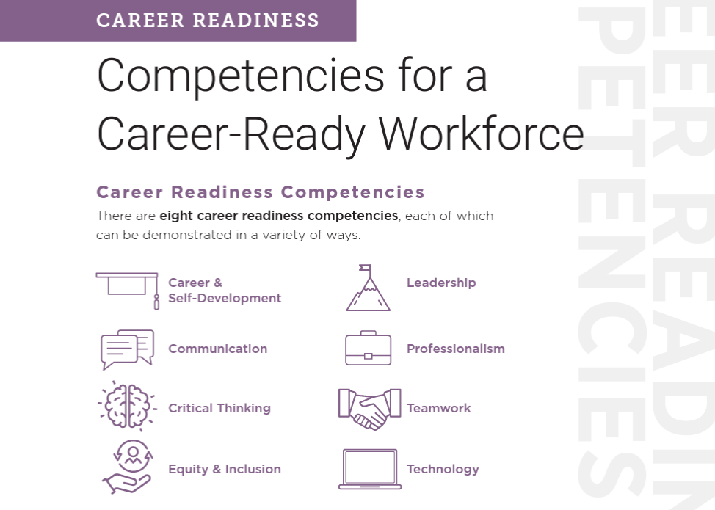
Competitive Professional Edge
According to the National Association of College and Employers (NACE), employers want students to demonstrate the awareness, attitude, knowledge, and skills required to equitably engage and include people from different local and global cultures.

Slide 15
When do you center the student in Global Learning?
“Where is the beauty, the resistance, the joy, the art, the healing, redemption, and the humanity and ingenuity of people making something out of nothing? … my student’s log illustrates the need for more robust conversations about culture, race, and learning styles.”
Notes:
Hope - Historically in COIL collaborations, professors have been at the center of the development and design of a COIL project. The content and relationship of the professors were designed with the student learning outcomes in mind but the focus was the professor
s focus to facilitate the apprehension of their joint curriculum with a cursory or peripheral comprehension an of the cultural differences. .
Vitor - I gladly share the commitment from UFF of promoting inclusivity as one of its main institutional goals. The particular program that I had the pleasure of developing COIL with Taur through the SUNY COIL Center, PULE, has as its goal offering students from a socioeconomic vulnerability background access to the tools for academic internationalization through language learning. It’s a shared work with teachers, administrators and students themselves to achieve this goal, and I’m certain the structure of this program promoted a more student-centered approach.
Abby- as we see the decline of students entering higher education
Taur - Students deserve to see themselves as agents of their own change. Empowering students and anchoring them in reality and seeing the power of education through those experiences.

Slide 16
“It was particularly interesting to see the strong attachment to language and culture from the perspective of a minority language compared to my perspective as a speaker of a dominant language and culture, as well as the awareness that I myself have had to reflect little on this side of my identity.”
“Students of today need competencies for the working world of tomorrow - instead of learning these only in theory, we experienced and developed intercultural and digital competencies in our COIL scenario.”
“Our group recordings were the highlight of my weeks.”
Career preparation
Reflecting
“The group work process was mega, it was very different from previous group work I've seen. I thought it was pretty cool that the chicas were totally up for doing something. We did a zoom meeting and everyone was so on target and efficient.”
“The feeling of the project has been that there is no wrong way to complete the tasks as long as we are discussing, engaging, and reflecting critically about our culture and our partner’s culture.”
WHY COIL?
Because we cannot do without it.
Teamwork
“Collaborations should last at least 6 sessions and let students should work together off the sessions.”
“I suggest that teachers give only one or two presentations to introduce the topic, so that we have more time for group work and presentation of the work.”
Culturally connecting
“The discussion culture of the Colombian group was particularly interesting for me. On the one hand, they actively participated, but on the other hand, they always invited people to join in. This resulted in a more intensive exchange than in other seminars with a very respectful atmosphere.”
“I really liked the cooperation. I hope that there are going to be similar programs in the future. I think it is very profitable to cooperate and exchange as we did.”
Slide by: COIL.UP

Slide 17
Getting ready to COIL

Slide 18
Planning a COIL Collaboration
2 instructors
2 classes
2 cohorts of students
2 institutions
2 or more cultures
2 languages
1 embedded module
Co-taught
Collaborative project/task
Online
Intercultural
Interdisciplinary
complexity

Slide 19
Considerations
Time and duration
Language
Course content
Assessment
Technology and Access
Institutional Cultures and Expectations
Available Support

Slide 20
Schedule of developing a COIL collaboration
Interested in COIL
Talk to Coordinator
Take Foundation course
Run collaboration
Find partner
Design collaboration with Partner
Semester 1
Semester 2

Slide 21
Lining up Academic Calendars…

Slide 22
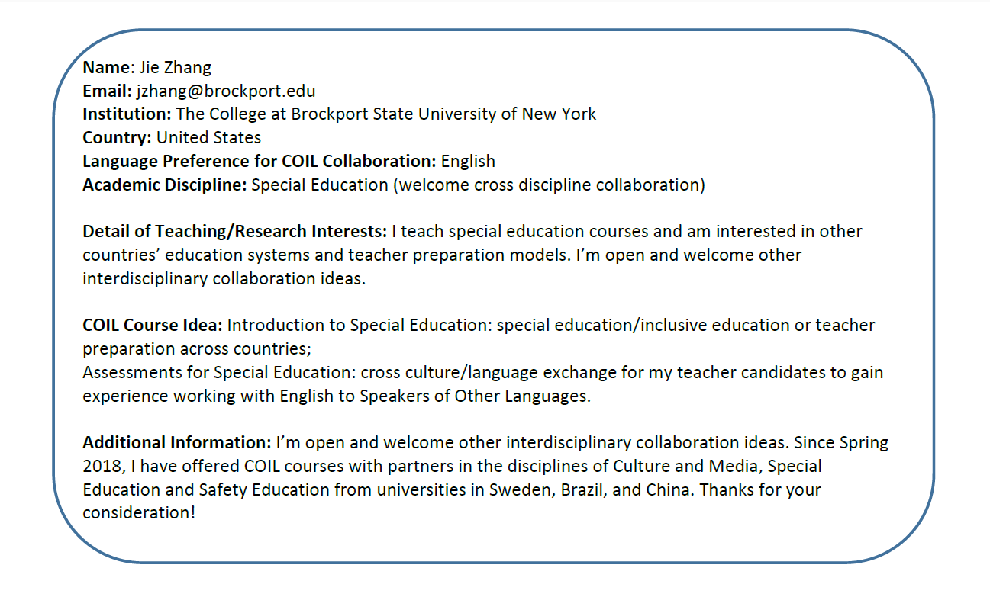
Partnering Process
Example from Partnering Bulletin
Partnering Fair takes place in Feb, May, Sept, Nov
example from Partnering Site

Slide 23
Weekly Idea hub Meetings
Fridays@11amET
Monthly Community Webinars
3rd Weds @ 12pmET
Training
Worksheets
Exemplars
Workshops
Strategic planning
Global network of practitioners
Monthly meetings
Webinars
Task & working groups
Conferences
Simplifying the process
Professional community of Practice
Monthly Coordinator Meetings
1st Tuesday @10amET
1st Weds @ 1pmET
Partnering Fairs & Bulletin
Feb, May, Sept, Nov
2nd Tuesday @9amET
Making meaningful connections
Resource Development
Partnering fairs
Listserv
Faculty recognition
Regional meet ups
Faculty guide
Institutional asset mapping
Tips and tricks
Evaluation and assessment
Annual Global Guest program
March - May
Notes:
How we can help you grow COIL at your university

Slide 24
Professional Development
How do I …
COIL
Foundations
COIL
Elements
COIL
Design
COIL
Coordinate
COIL
Administrate
3 weeks online
3 ZOOM meetings
3 weeks online
3 ZOOM meetings
3 weeks online
3 ZOOM meetings
3 weeks online
3 ZOOM meetings
3 weeks online
3 ZOOM meetings
Talk through Culture
Work in online teams
Design your COIL project
Implement COIL campuswide
Support
COIL campuswide
coil.suny.edu/professional-development

Slide 25
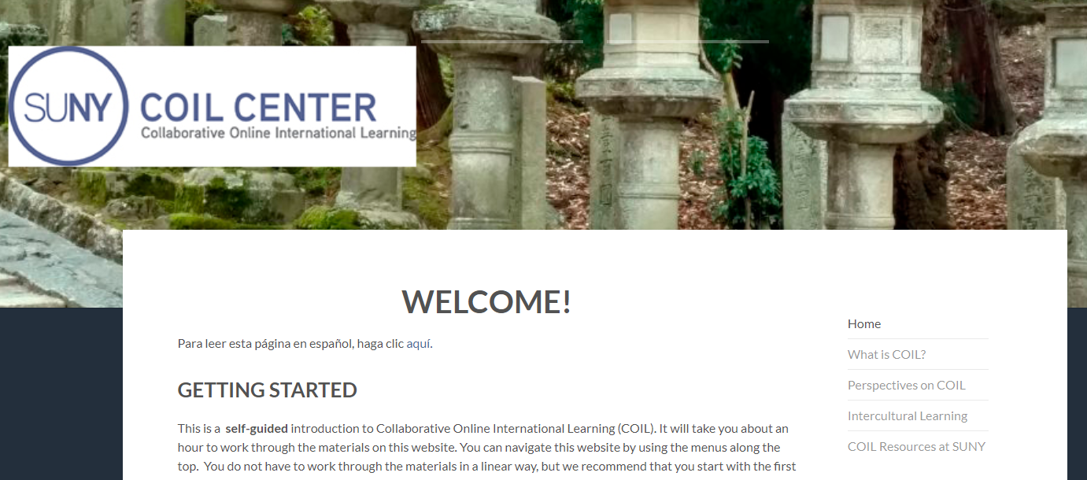
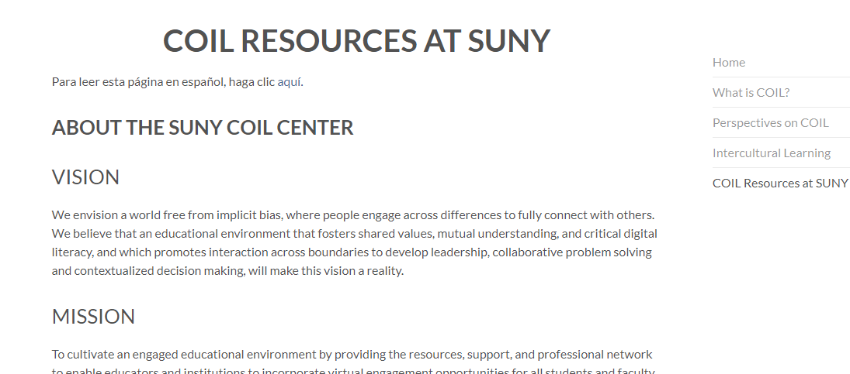
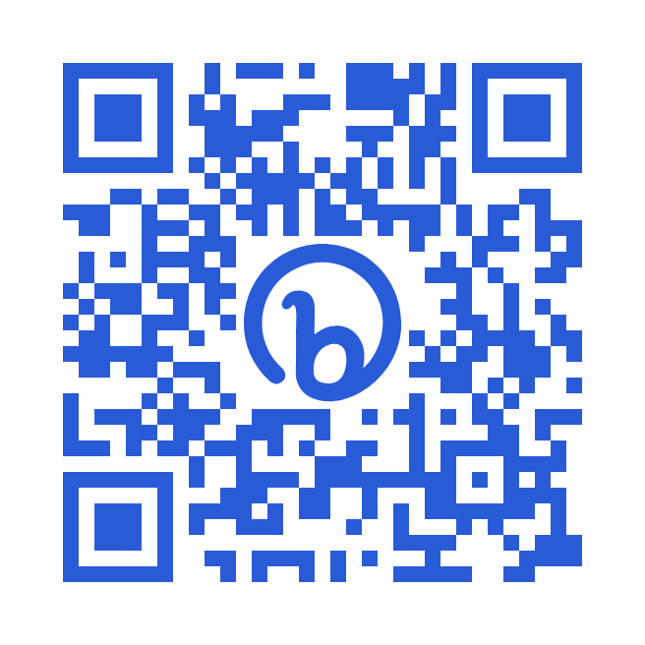
START HERE
Self paced introduction to COIL
Available in Spanish and English
Open to everyone!
bit.ly/whatisCOIL
COIL is an invitation to work together from the future. NOW
COIL Administrator, Portland State University

Slide 26
Questions? Answers?
Reflections?
Thank you for coming!
bit.ly/whatisCOIL
coil.suny.edu
Hope Windle

