Slide 1
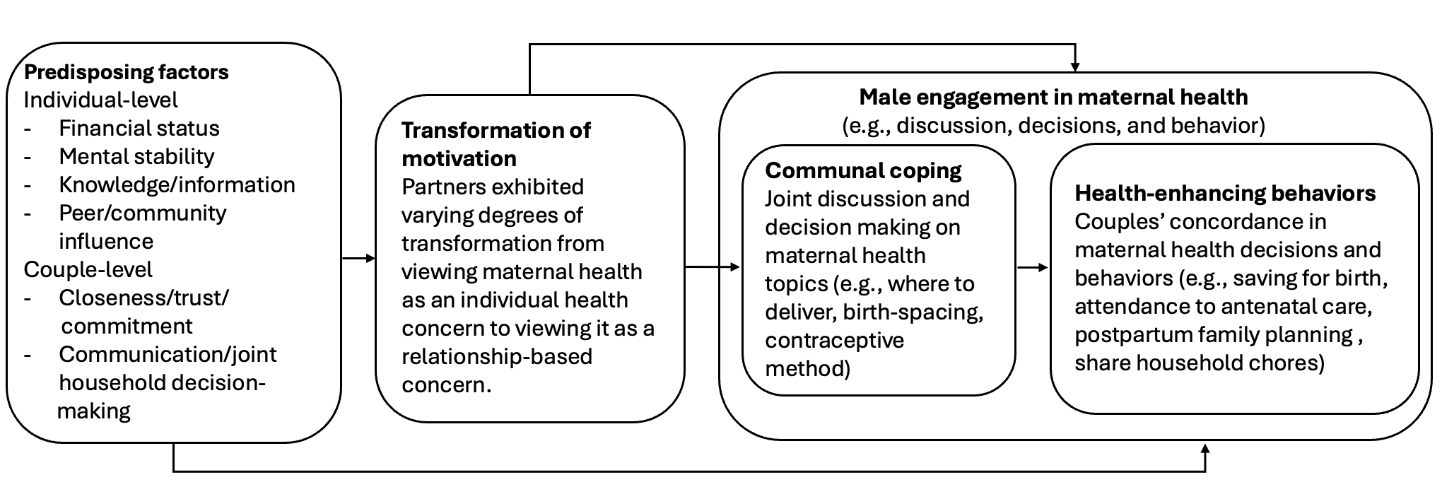
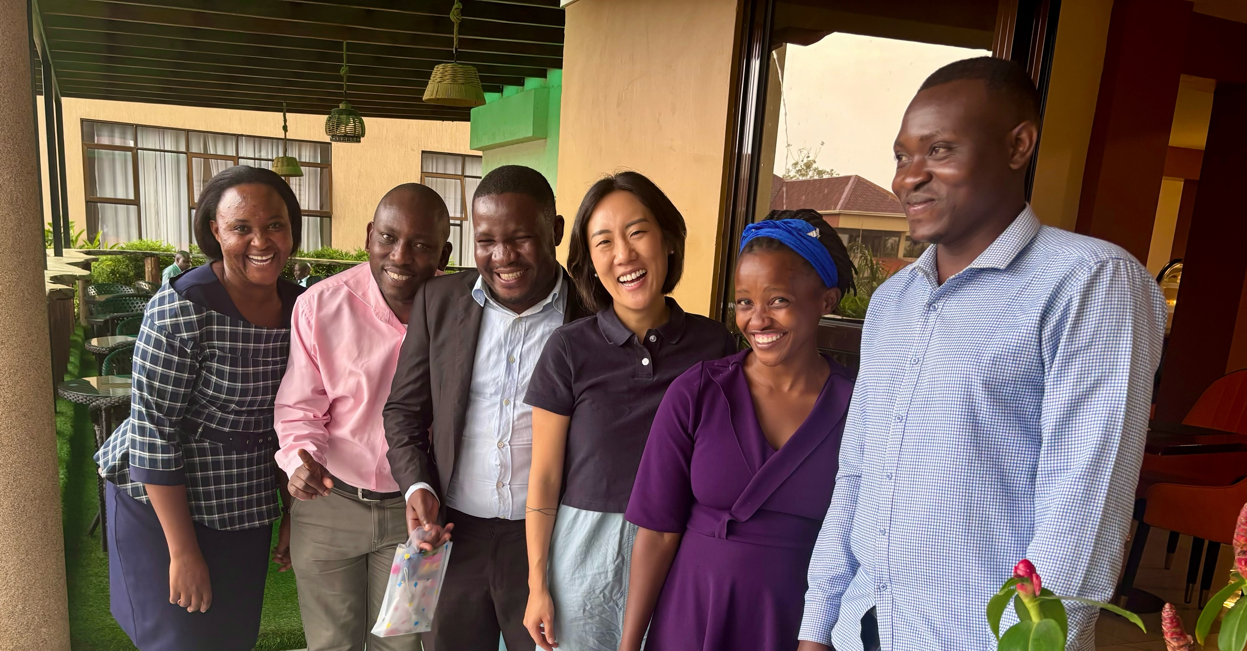
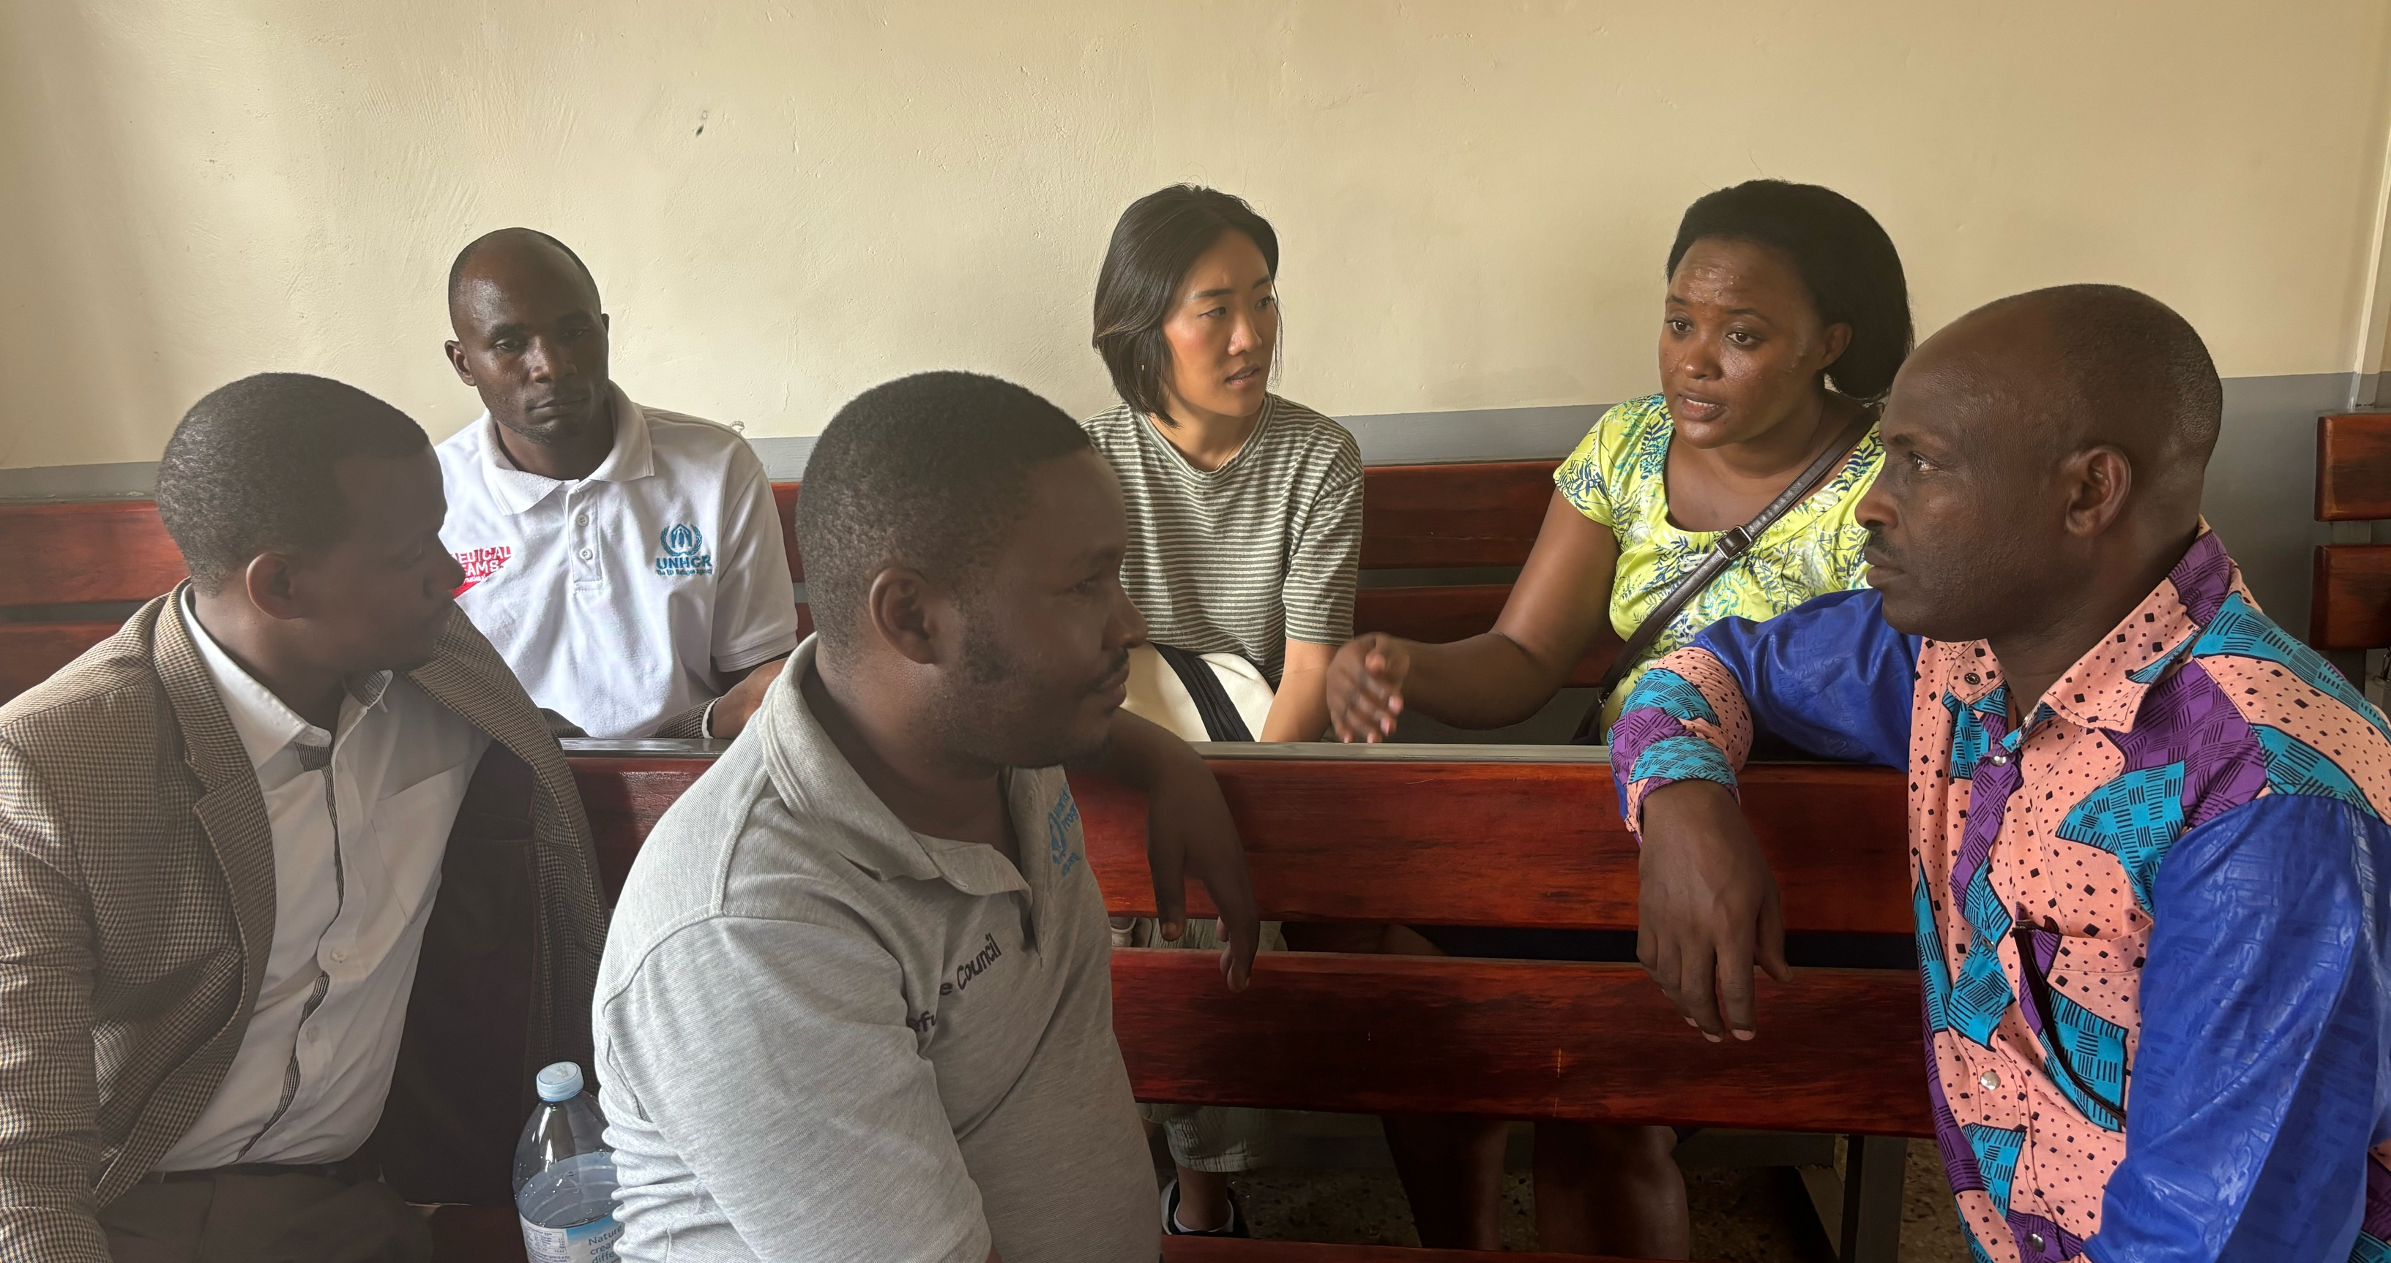
Exploration of Nakivale refugees’ and stakeholders’ perceptions and priorities of male engagement in maternal health: a qualitative study
HaEun Lee, PhD, RN; Donath Asiimire, PhD; Johnson Atwiine, PhD; Betrum Namanya, PhD (c); Richard Nsengiyumva, PhD (c); Lynae Darbes, PhD; Fred Sheldon Mwesigwa, PhD
Background
Results
Uganda, one of the largest refugee-hosting countries in Africa, currently accommodates 1.62 million refugees.^{1,2}
Refugee and displaced women face significant barriers such as poverty, loss of livelihood, disruption of healthcare services, and the severance of existing social support networks, to accessing timely and effective maternal health services.^{3,4,5}
Lack of men's engagement significantly influence refugee women's access to and utilization of maternal health services.⁶
Increased male engagement in maternal health has been linked to improved antenatal care (ANC) attendance, readiness for pregnancy-related complications, better maternal nutrition, higher likelihood of delivery with skilled birth attendants, and enhanced postpartum care attendance.⁷
Despite the documented benefits of involving men in maternal and child health interventions, there is a lack of research on the role of men in maternal health interventions within conflict settings.⁸
Table 1. Brief demographic characteristics of participants.
Figure 1. Adapted interdependence model of communal coping and health behavior change for maternal health.
 | Total | Individual interviews | Focus group discussions
 | N=78 | N=14 | N=64
Gender, n (%)
Men | 43 (61.4%) | 12 (85.7%) | 31 (48.4%)
Women | 27 (38.6%) | 2 (14.3%) | 33 (51.6%)
Marital status, n (%)
Married | 60 (76.9%) | 12 (85.7%) | 48 (75.0%)
Divorced/separated/widowed | 7 (9.0%) | 1 (7.1%) | 6 (9.4%)
Single/never married | 11 (14.1%) | 1 (7.1%) | 10 (15.6%)
Education level, n (%)
Primary of lower | 50 (64.1%) | 0 (0.0%) | 50 (78.1%)
Secondary or higher | 28 (38.3%) | 14 (100%) | 14 (21.9%)
Desired number of children n (SD) | 5.2 (2.0) | 4.6 (2.4) | 5.3 (1.8)
Number of total children | 4.5 (2.5) | 4.4 (2.7) | 4.6 (2.5)
Age of youngest child
5 years or younger | 56 (71.8%) | 11 (78.5%) | 45 (70.4%)
Older than 5 years | 14 (17.9%) | 1 (7.1%) | 13 (20.3%)
Not applicable*/missing | 8 (10.3%) | 2 (14.3%) | 6 (9.4%)
Country of origin, n (%)
Democratic Republic of Congo | 19 (24.4%) | 3 (21.4%) | 16 (25.0%)
Burundi | 17 (21.8%) | 1 (7.1%) | 16 (25.0%)
Rwanda | 19 (24.4%) | 4 (28.6%) | 15 (23.4%)
Somalia | 17 (21.8%) | 0 (0.0%) | 17 (26.6%)
Uganda | 6 (7.7%) | 6 (42.9%) | 0 (0.0%)
Years lived/worked in Nakivale refugee settlement n (SD) | 12.3 (6.0) | 10.3 (7.2) | 12.8 (5.6)
Table 2. Quotes related to effective and ineffective communal coping.
Table 3. Quotes related to health enhancing behaviors.
Communal coping
Effective | “…when a man and a woman talk and decide on family planning methods... they sit down and decide that since (a specific type of) family planning has failed, let’s use condoms. But between them, one may not buy the idea... one says, ‘I don’t want it (condom).’ Then the man tries and leaves you alone and says, ‘woman, let me leave you alone, don’t cause me problems of maybe making you pregnant again…So it helps him take care very well based on the decisions we both made.’” (Congolese woman, FGD)
Ineffective | “I know one family... the husband told the wife that he didn’t want a third child... the wife conceived, and the daddy immediately left the family... they are there struggling with life because they produced without planning.” (Zone-based community leader, IDI)
Health Enhancing Behaviors
Use family resources for maternal health | “…. Immediately after conception, you get to know how to take care of the pregnancy up to the time of birth. You look out for the baby’s clothes at birth, get to know that it shall need a baby shawl to carry the baby...” (Congolese man, FGD)
Joint attendance in ANC and checkups | “The first thing is supporting her and accompanying getting to the doctor and do all the tests related to pregnancy.” (Burundi man, FGD)
Uptake of contraceptive methods | “To me, the way we do it, although most times I don’t see it here in hospitals, is by using the beads method. It was so helpful without taking any tablet or injection... After your periods, you would know the days to spend before meeting up with a man based on the way you agreed and understand each other.” (Congolese woman, FGD)
Sharing household chores | ““when he knows that the wife is pregnant, he doesn't let her do heavy work and gives her food that prevent diseases including greens and are on the side of the wife. It makes the baby inside to feel well.” (Burundi woman, FGD)
Table 1 shows participants demographic characteristics.
Our adapted model in Figure 1 identifies two levels of predisposing factors influencing male-engagement in maternal health: individual (men’s financial stability, mental health, knowledge, and peer/community influence) and couple-level (closeness, trust, commitment) factors.
Transformation of motivation assessed through language—high motivation reflected shared responsibility (“we/us/our”), while low motivation indicated separate roles (“she/her” or “he/him”).
Communal coping, where couples jointly manage health decisions (Table 2), led to health-enhancing behaviors like resource planning, family planning, and sharing household tasks (Table 3).
Unlike the original interdependence model, we incorporate male engagement, emphasizing its role in communal coping and health-enhancing behaviors, reinforcing that maternal health requires men’s active participation.
Aim
This study explored the perceptions and priorities of African refugees and key stakeholders in Nakivale refugee settlement, Uganda, regarding men’s engagement in maternal health.
Methods
Focus group discussions with African refugee men and women of the four most represented nationalities (Congolese, Burundians, Rwandese, and Somalis) in Nakivale settlement.
Individual in-depth interviews with key stakeholders, including healthcare providers (midwives, nurses, physicians), religious leaders (Anglican priests, Catholic priests, Pentecostal pastors), zone-based community leaders, and the refugee settlement commandant.
Data collection utilized semi-structured interview guides and a brief demographic survey.
All data were collected between April and May 2024.
Qualitative data were analyzed using a deductive approach based on the’ interdependence model of communal coping and behavior change.⁹
Discussion &Conclusions
Maternal health should be reframed as a shared responsibility between partners, not solely a women’s issue.
Both individual and relational factors shape African refugee couples’ joint efforts toward optimal maternal health.
To effectively engage African refugee men and couples to improve outcomes, interventions must prioritize men’s involvement alongside women-focused efforts, eventually addressing couples together.
Future interventions should address diverse topics such as financial literacy, income-generating skills, mental health support, and family planning education.
Involving community leaders and utilizing existing savings groups were suggested strategies to boost participation and ensure the intervention’s success.
Picture 1. Dr. Asiimire, Dr. Atwiine, and Dr. Lee with local research assistants of refugee backgrounds.
Picture 2. Dr. Lee and Dr. Asiimire interviewing religious leader with a translator.
References
1. UNHCR. Nakivale Settlement Profile Isingiro District, Uganda. UNHCR, UN Habitat; 2020.
2. UNHCR. Uganda Refugee Response Plan (RRP) 2022-2023. UNHCR; 2023.
3. Ivanova O, Rai M, Kemigisha E. A Systematic Review of Sexual and Reproductive Health Knowledge, Experiences and Access to Services among Refugee, Migrant and Displaced Girls and Young Women in Africa. IJERPH. 2018;15(8):1583. doi:10.3390/ijerph15081583
4. Bendavid E, Boerma T, Akseer N, et al. The effects of armed conflict on the health of women and children. The Lancet. 2021;397(10273):522-532. doi:10.1016/S0140-6736(21)00131-8
5. Van Boekholt TA, Moturi E, Hölscher H, Schulte‐Hillen C, Tappis H, Burton A. Review of maternal death audits in refugee camps in UNHCR East and Horn of Africa and Great Lakes Region, 2017–2019. Intl J Gynecology & Obste. 2023;160(2):483-491. doi:10.1002/ijgo.14504
6. Ackerson K, Zielinski R. Factors influencing use of family planning in women living in crisis affected areas of Sub-Saharan Africa: A review of the literature. Midwifery. 2017;54:35-60. doi:10.1016/j.midw.2017.07.021
7. Yargawa J, Leonardi-Bee J. Male involvement and maternal health outcomes: systematic review and meta-analysis. J Epidemiol Community Health. 2015;69(6):604-612. doi:10.1136/jech-2014-204784
8. Wagner Z, Heft-Neal S, Wise PH, et al. Women and children living in areas of armed conflict in Africa: a geospatial analysis of mortality and orphanhood. The Lancet Global Health. 2019;7(12):e1622-e1631. doi:10.1016/S2214-109X(19)30407-3
9. Lewis MA, McBride CM, Pollak KI, Puleo E, Butterfield RM, Emmons KM. Understanding health behavior change among couples: An interdependence and communal coping approach. Social Science & Medicine. 2005;62(6):1369-1380. doi:10.1016/j.socscimed.2005.08.006

