Slide 1
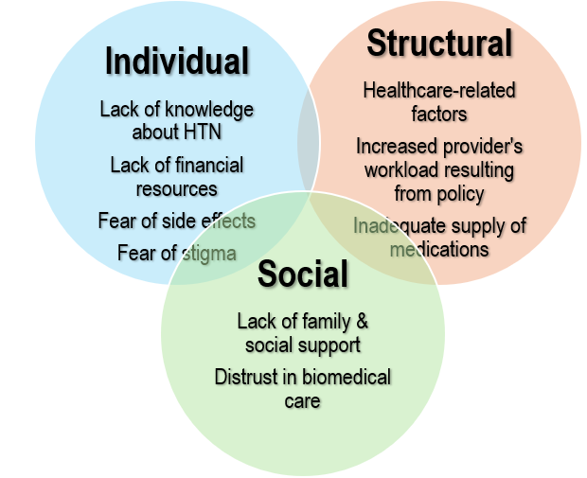
Navigating Hypertension Care: Provider & Administrator’s Views on Hypertension Treatment Adherence in Tanzania
Mirlene Perry,¹ Clotilda Tarimo,² Lisa Carnago,¹ Kelvin Haukila,³ Michael Relf,¹ Pearson Mwemezi,⁴ Blandina Mmbaga,² Ismail Shekibula,⁵ and Brandon Knettel^{1,5}
¹Duke University School of Nursing, USA; ²Kilimanjaro Christian Research Institute, Tanzania; ³Kilimanjaro Christian Medical Centre, Tanzania; ⁴Kilimanjaro Christian Medical University College of Medicine, Tanzania; ⁵Duke Global Health Institute, USA
INTRODUCTION
RESULTS
Hypertension (HTN) is the largest modifiable risk factor for preventing cardiovascular deaths, yet nearly 80% of people with HTN worldwide do not have their blood pressure under control, most of whom live in low- and middle-income countries (LMICs). ^{1,2}
In Tanzania, 25-40% of adults have hypertension, but only 7% have their blood pressure under control. ^{3,4}
A key challenge to HTN control is poor treatment adherence after diagnosis.
Challenges to adherence are multifaceted, and may include intrapersonal, interpersonal, and systemic factors, as well as social determinants of health. ^{5,6}
Emergent Themes from the Data
Key Findings
Three major domains emerged as factors influencing HTN treatment adherence in Moshi, Tanzania: patient-related factors (Individual), structural factors (System), and social factors (cultural and interpersonal).
The factors are interconnected and offer avenues for multilevel interventions.
It is important to include patient’s perspectives in next steps for a more comprehensive understanding.
RESULTS
PURPOSE
Themes | Sub-Themes | Quote Exemplars
Individual | Lack of knowledge about HTN Lack of financial resources required for Rx Fear of HIV-related stigma Fear of side effects Lack of motivation to adhere with Rx | “So financial issue is the biggest issue that hinders the overall control of hypertension.” “And sometime event the patient tells you: if I have to go and buy these medications, then please do not write it for me.” “The knowledge gap is very big, and it is something we have been working on but it needs more effort to cover it.” “Another thing is some patients suffer from complications of medications, and they feel bad because of the side effects and now we have a narrow range of medications.”
Structural | Health-system-related factors: shortage of providers; long waits at clinics; long distances to facilities; lack of patient rapport, limited times with providers, regimen complexity Increased workload (or complications) produced by national policy for HTN Rx among the elderly Inadequate supply of medicines requiring patients having to return for frequent re-supply | “Some others won’t come back for follow up maybe for different reasons, like maybe financial issues and sometimes they can just not come back because the queue is too long and the patient cannot wait.” “So you will find that most of the clients will go where they hear there is no cost or where the cost is low compared to other places.” “We normally have a lot of clients every single day because people have been given medications for just one week.” “You can provide very good knowledge but still when the patients come to the hospital, there are no medications.”
Social | Lack of family and social Distrust in modern healthcare | “And in the place that I work normally, it’s like elders are being abandoned. When you try to ask the social history part, you find that he/she is living alone.” “I think it is because of custom and traditions and families and what they believe in. They think the spiritual leaders or traditional leaders can help them to solve the problem.” “I asked the patient: ‘Do you know that you have very high blood pressure?’ The patient replied that: ‘Yes I know but I normally do prayers to one of the prophets we have here in Tanzania he is called ……you have heard of him?’.”
To explore perspectives of healthcare providers and administrators on factors affecting HTN treatment adherence in three clinics in Moshi, Tanzania
METHODS
Qualitative Descriptive Study
Eligibility criteria
18 years or above
Health provider or administrator
Providing care in 1 of 3 clinics at least 3 months before interview
The 3 clinics contained 1 referral hospital and 2 health centers
Data collection
We purposefully recruited 16 HTN health providers and administrators for semi-structured interviews
Interviews lasted 45-60 minutes and were conducted in English or Swahili, depending on the participant’s preference
Interviews were audio-recorded and transcribed verbatim
Data analysis
Content analysis using NVivo 14 software
Peer examination
CONCLUSION
SAMPLE CHARACTERISTICS (N=16)
CONCLUSIONS & NEXT STEPS
REFERENCES
Demographics
Mean age of participants: 37 yrs
Gender: Female 60%
Race: Black Africans 100%
Types of providers
18% Physicians
32% Medical Officers (equivalent to PA)
25% Nurses
25% Administrative roles
Years of experience
56% 4-10 yrs
37% 1-3 yrs
7% 10+ yrs
This study highlights contextual providers’ perspectives in optimizing HTN treatment in Tanzania and similar settings.
Future research should include insights from patients and community leaders to gain a comprehensive understanding of adherence and to develop effective intervention strategies.
Additionally, studies on medication adherence could identify practical strategies to enhance adherence and improve outcomes.
Nguyen, T. N., et al., (2021). Global and national high blood pressure burden and control. The Lancet, 398(10304), 932–933. https://doi.org/10.1016/S0140-6736(21)01688-3
World Health Organization. (2023). First WHO report details devastating impact of hypertension and ways to stop it. https://www.who.int/news/item/19-09-2023-first-who-report-details-devastating-impact-of-hypertension-and-ways-to-stop-it
Roman, W. P., et al., (2019). Cardiovascular diseases in Tanzania: The burden of modifiable and intermediate risk factors. Journal of Xiangya Medicine, 4(0), Article 0. https://doi.org/10.21037/jxym.2019.07.03
Pallangyo, P. et al., (2022). Medication Adherence and Blood Pressure Control Among Hypertensive Outpatients Attending a Tertiary Cardiovascular Hospital in Tanzania: A Cross-Sectional Study. Integrated Blood Pressure Control, 15, 97–112. https://doi.org/10.2147/IBPC.S374674
Olsen, M. H., et al., (2016). A call to action and a lifecourse strategy to address the global burden of raised blood pressure on current and future generations: The Lancet Commission on hypertension. Lancet, 388(10060), 2665–2712. https://doi.org/10.1016/S0140-6736(16)31134-5
Schutte, A. E., et al., (2023). Addressing global disparities in blood pressure control: Perspectives of the International Society of Hypertension. Cardiovascular Research, 119(2), 381–409. https://doi.org/ 10.1093/cvr/cvac130
ACKNOWLEDGEMENTS
Duke School of Nursing Holditch-Davis Pilot Grant; Duke Graduate School; Duke Global Affairs; Our Tanzanian Colleagues in Moshi; Beverly Murphy, Duke Medical Center Library & Archives

