Slide 1
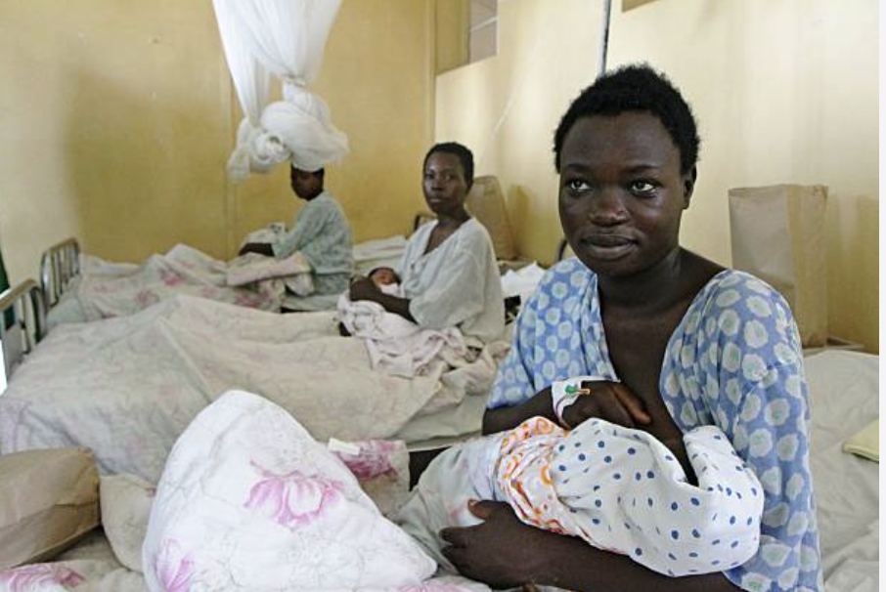
Socio-Economic and Obstetric Disparities in Cesarean Deliveries in Rwanda
Marie Josee Mwiseneza, MSc, BSc, RN¹; Emeline Umutoni Cishahayo, MSc, RN¹, Richard Kalisa, MD, M.Med (Peds)²,
Etienne Nsereko, MSc, FCRE,PhD³, Patricia Moreland, PhD, CPNP, RN, FAAN⁴.
University of Rwanda, College of Medicine and Health Sciences, School of Nursing and Midwifery ¹, University of Rwanda, College of Medicine and Health Sciences, School of Public Health,² University of Rwanda, College of Medicine and Health Sciences, School of Allied Health Sciences,³ Emory University Nell Hodgson Woodruff School of Nursing⁴,
Background
Methods
Results
Cesarean delivery (CD) is a critical obstetric intervention that saves the lives of mothers and newborns. However, the rising prevalence of CD has become a global public health concern.
The rate of CD in Rwanda has increased significantly over the past two decades from 2.2% in 2000 to 15.6% in 2019-2020.
Rwanda’s current CD rate is three times higher than the average in Sub-Saharan Africa and exceeds the World Health Organization (WHO) recommended 10-15% range.
CD rates in Rwanda are approximately four times higher in the private sector than in the public sector.
Research demonstrates that maternal mortality following CD in low-and-middle income countries (LMICs) is approximately 100 times higher than in high-income countries.
The increasing CD rate in Rwanda has significant public health implications as it may result in significant maternal and child morbidity and mortality.
A cross-sectional study was conducted in one private and three public hospitals in Kigali, Rwanda from November 20, 2023 to February 20, 2024.
A total of of 5,520 postpartum women aged 15-49 years were included in the study.
Descriptive analysis, including univariate and bivariate methods assessed the characteristics and prevalence of CD. Multiple binary logistic regression identified factors associated with CD.
The overall prevalence of cesarean deliveries (CD) was 43.5% (n=2403). Advanced maternal age (> 35 years) increased the likelihood of CD (OR=1.688, 95% CI:1.169-2.440, p=0.005). Women with primary (OR=2.431, 95% CI:1.476-4.005, p=0.001) and secondary education (OR=1.829, 95% CI: 1.550-2.158, p <0.001) had higher odds of CD compared with those with no formal education. Women living with a partner (OR=1.267, 95% CI:1.057-1.520, p=0.011) and employed women (OR=1.466, 95% CI=1.245-1.727) had increased odds of CD. Delivery sites varied with lower odds of CD at Kibagabaga Hospital (OR=0.542, 95% CI: 0.43-0.69, p=0.001), Muhima Hospital (OR=0.671, 95% CI: 0.53-0.84, p=0.001, or Masaka Hospital (OR=0.405, 95% CI: 0.32-0.51, p=0.001) compared to La Croix du Sud Hospital. Obstetric factors showed that fewer pregnancies (gravidity one or two) were linked to lower odds of CD (OR=0.513, 95% CI: 0.423-0.623), whereas multiple pregnancies and a history of CD significantly increased the risk of CD (OR=181.067, 95% CI: 57.115-574.020, p=0.001;OR=176.144, 95% CI: 55.72-556.79, p<0.001). Multiple fetus also increased the odds of CD (OR=2.271, 95%CI: 1.581-3.261, p<0.001).
Purpose
The purpose of this study was to assess the prevalence of CD in four health facilities in Kigali, Rwanda and to examine the socio-economic and obstetric factors associated with CD delivery.
Understanding the prevalence and associated socio-economic and obstetric factors of CD in Rwanda will contribute to the development of context-specific interventions to improve maternal and neonatal outcomes following CD.
Conclusions and Implications
The prevalence of CD rates in Rwanda exceeds the WHO recommended range. Significant social, economic, and obstetric disparities were noted. Women at public hospitals had lower odds of CD compared to those at the private hospital.
Acknowledgements
This study was funded by Emory University Global Health Institute.

