Slide 1
Being an Effective Mentor and/or Mentee
April 24, 2025
Presented by: Ana Sfoggia MD MSc, Elizabeth Rose EdD MPH, Joseph Becker MD, Purba Chatterjee MSc
Moderated by: Amy Moore DNP APRN FNP-C

Slide 2
Session Objectives
5
Understand the CUGH Mentorship Program
1
Describe attributes of effective mentors and mentees
4
Know mentoring resources
2
Identify characteristics of successful mentor-mentee partnerships
3
Address potential challenges in mentoring relationships

Slide 3
What is mentorship?
Please type a few words in the chat to describe “mentorship”
Notes:
Ana
Ask participants to type a few words in the chat to describe mentorship

Slide 4
One definition of mentorship
“Mentorship is a professional, working alliance in which individuals work together over time to support the personal and professional growth, development, and success of the relational partners through the provision of career and psychosocial support.”
National Academies of Sciences, Engineering, and Medicine; Policy and Global Affairs; Board on Higher Education and Workforce; Committee on Effective Mentoring in STEMM; Dahlberg ML, Byars-Winston A, editors. (2019) https://www.ncbi.nlm.nih.gov/books/NBK552775/
Notes:
DO NOT READ THE SLIDE. Instead, say something like: Here’s a definition of mentorship. The mentor guides the mentee in the development and re-examination of his or her own ideas, learning, personal and professional development.

Slide 5
Mentoring has a broad scope
Career functions
Personal functions
Sponsor
Coach
Advisor
Tutor
Protection
Challenge
Exposure and visibility
Role model
Problem solving and counseling
Acceptance and affirmation
Kram, KE. Mentoring at Work: Developmental Relationships in Organizational Life, 1988
Tobin MJ, Mentoring: Seven Roles and Some Specifics. Am J Respir Crit Care Med, 2004
Notes:
Sponsorship: mentor opens doors that would otherwise be closed
Coaching: the mentor teaches and provides feedback
Protection: supports protégé and/or acts as a buffer
Challenge: the mentor encourages new ways of thinking and acting and pushes the protégé to stretch her capabilities
Exposure and visibility: steer protégé into assignments that increase recognition within the organization
Role modeling; mentor demonstrates the kinds of behaviors, attitudes and values that lead to success in the profession
Counseling: helps protégé deal with difficult professional dilemmas.
Acceptance/Confirmation: supports the protégé and shows respect

Slide 6
Mentoring is important…
Enhances mentee productivity, self-efficacy & career satisfaction (Garman et al., 2001; Feldman et al., 2010 ; Cho et al., 2011; Fleming et al., 2012 )
Serves as a predictor of success for trainees (Shea et al., 2011; Steiner et al., 2004 )
Strengthens decision-making around academic persistence (Gloria and Robinson Kurpius, 2001)
Cited as the most important factor in degree attainment (Solorzano, 1998)
Benefits underrepresented students in health sciences (Tsen et al., 2012)
Notes:
DO NOT NEED TO READ EVERYTHING. Instead, say something like: I know that you are at this webinar because you believe mentoring is important, so I won’t belabor the point but just show a few of the many studies that emphasize the importance of mentoring
Strong mentorship has been linked to enhanced mentee productivity, self-efficacy (one's belief in one's ability to succeed), and career satisfaction;
It is also an important predictor of the success of researchers in training and leads to more publications/grants
Mentored students are more likely to make decisions leading to academic persistence
…with positive mentoring being cited as the most important factor in degree attainment
Benefits for minority populations – increase exposure and retention, significant predictor of high research productivity
Despite these benefits, minority populations individuals typically receive less mentoring than their non-minority peers and even those in the academe note inadequate mentoring, lack of understanding about institutional processes and lack of insititutional support among other things pose obstacles to success

Slide 7
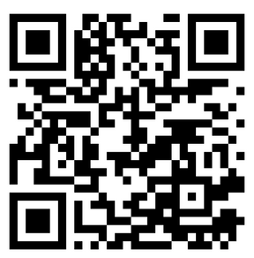
Mentoring is important in decolonisation
Reduce power imbalances by fostering equitable partnerships between researchers from the Global South and the Global North
By adopting a decolonial approach to mentorship, the global health community can transform mentorship relationships into more equitable, empowering and sustainable collaborations
Decolonisation requires continuous self-reflection, openness to change, and a commitment to dismantling systemic inequities in global health
Notes:
BE BRIEF (this topic could be a whole presentation :) )

Slide 8
Effective mentors and mentees
Attributes, characteristics, and responsibilities
Notes:
Elizabeth

Slide 9
Reflect for a moment:
Think about being in a mentoring relationship…
What was the experience like?
Did you know …what to expect? …how to engage in the partnership? …your role and responsibilities? If so, how did you know?
Notes:
So, these questions can be

Slide 10
Successful mentoring relationships
Straus et al. Academic Medicine 2013.
Reciprocity
“It’s got to be a 2-way street. It can’t be just a one-way giving relationship because then it’s going to burnout.”
Mutual respect for each others’ time, effort, qualifications
“Both individuals have to respect the qualifications of the other and the needs of the other and work together towards a common goal.”
Clear expectations
“It’s helpful to set up guidelines in the beginning.”
Shared values
“Mentorship worked best when mentors and mentees had similar interests and values.”
Personal connection
“Important to have a connection, where you feel the mentor cares about you.”
Notes:
54 interviews with faculty at Univ of Toronto and UCSF
Reciprocity
Mentoring is collaborative; mentees are not passive recipients of a mentor’s guidance. Ideally, mentees and mentors engage as partners through reciprocal activities such as planning, acting, reflecting, questioning, and problem-solving. This dynamic relationship changes over time
Some ways that mentors benefit include: expand their network with adding mentees, be exposed to new ideas, and potentially have help on a manuscript or project
Mutual respect
Mentorship works towards a common goal; important to respect the place that each person is in their career
In respecting the others’ time, be mindful of agreed upon ways and times for communication
Clear expectations
At the beginning, discuss goals and parameters of the mentoring relationship - do not assume anything – ex: of scholar who emailed to say he was setting up weekly mentoring
Discuss frequency (monthly, quarterly, something else), meeting setting (in-person, remote, video call, regular call) and type of communication between meetings (text, email; time of day)
Discuss responsibilities - Who is responsible for scheduling meetings, agenda, report form, etc.?
Shared values
Personal connection
Invest plenty of time in the first few meetings in building a personal connection; knowing a bit about each other can help build trust and also provide the mentor insight to guide the mentee

Slide 11
Unsuccessful mentoring relationships
Straus et al. Academic Medicine 2013.
Poor communication
Mentors frustrated when their advice not followed. Mentees feel intimidated. Lack of open communication.
Different expectations
Mentee and mentor expect different things from the relationship: “recipe for disaster.”
Lack of commitment & time, wanning interest
“If you don’t get that kind of ongoing interest and commitment, you just realize that the fit or the value isn’t there anymore.”
Personality differences
One person is extraverted and the other introverted.
One person thinks on the fly and the other likes to think ahead of time.
Perceived (or real) competition
Mentor may feel threatened. Both need credit. Lack of clarity around intellectual property.
Notes:
Effective communication:
Effective communication is regular
Both parties actively listen
Mentees should act on advice of their mentors and provide feedback to the mentor, which can help them better advise in the future
Mentees should communicate why they want mentoring and their goals for being mentored (e.g., grow certain skills, guidance in career path, connections, etc.); be honest about challenges so that mentor can provide guidance
Mentors should be approachable and available
Different expectations
Setting clear expectations is important!
Lack of commitment, time
In setting expectations, be aware of each other’s time
Before entering a mentoring relationship, be honest about your ability to commit and interest
Personality differences
You may need to adapt your style of communicating – be sure to allow time for the other person to think through a question, be ready to listen, etc.
One person is extraverted and the other introverted.
One person thinks on the fly and the other likes to think ahead of time.
Competition
Might be real or perceived
As mentors, it’s important to remember that we’re raising the next generation – we can’t continue at our work forever and it is important to have well-trained and –mentored individuals ready to carry on the work
When collaborating on a manuscript, I give the mentee first authorship and I take senior authorship; important to discuss and agree upon in the beginning

Slide 12
Responsibility in the mentoring meeting
Action item | Mentor | Mentee
Determine frequency and setting of regular meetings | X | X
Send meeting agenda |  | X
Come prepared to meeting | X | X
Formulate goals and concise questions |  | X
Offer probing questions, guidance, and resources | X
Email meeting summary and next steps |  | X
Follow up on next steps |  | X
Notes:
Pose as a question - what are the responsibilities of mentor and mentees to prepare for meeting

Slide 13
GROW: A framework for mentoring conversations
Adapted from Alexander, G.; Fine, A.; & Whitmore, J.
Notes:
Goal - Mentee shares their goals for mentoring and for career growth; being specific helps the mentor guide the mentee; however, often the mentee might need help in creating specific, achievable goals, so the mentor should be ready to ask questions to help the mentee think through their career vision or skills/knowledge they need to reach the next level
Reality - Mentee should be honest about their ‘reality’, whether it’s a skills gap or a challenging situation at work; the mentor should provide encouragement as well as constructive feedback and ask probing questions to learn more and help the mentee understand root issues and stumbling blocks.
Obstacles/Options - Mentor can provide broader and different perspectives; encourage mentee to think critically and strategically through the situations; mentor shares information on opportunities – training, fellowships, papers, videos, conferences, people to connect with; encourage mentee to engage with other professionals and researchers
Way forward - Mentee decides on next steps including timeline to move closer towards their goal;

Slide 14
Benefits and Opportunities of Peer Mentorship
Co-mentoring or collaboration between individuals at similar levels of professional development
Focus on reciprocal learning
Promotes collegiality
Enhances the ability for mentees to expand their social network
Peers are often better able to address daily issues, especially if they have recently navigated similar experiences
Peers can be perceived as more approachable for certain discussions
Notes:
be brief

Slide 15
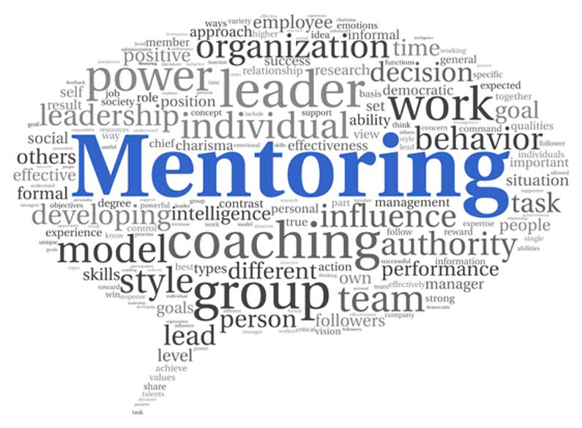
Mentor-mentee partnerships
Case studies and potential challenges
Notes:
Joe

Slide 16
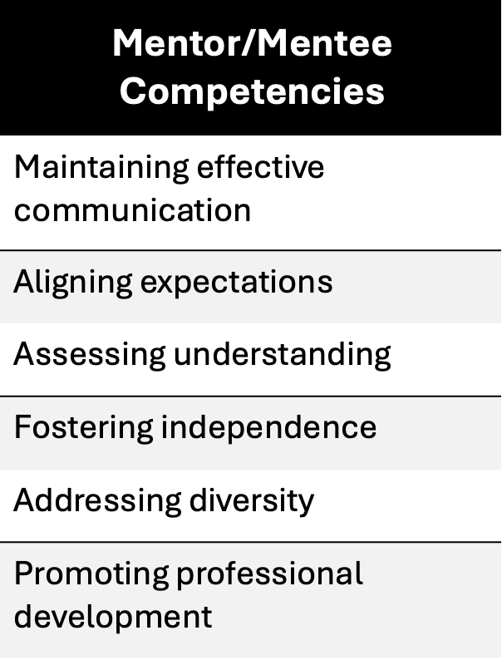
How to make mentorship (and menteeship) work
Real cases
Common pitfalls
Typical mentorship relationship trajectories
Defining success
Points of failure or expectation mismatch
Mentorship-menteeship approaches that work

Slide 17
Scenario 1: Context is Everything
Mentee: An African graduate student interested in global public health
Mentor: Senior faculty member at an American University
The mentee shares that she is often not heard by male colleagues
She is not offered academic opportunities to the degree her male counterparts are
The mentor advises that the mentee should complain directly to her director and confront her colleagues about their behavior

Slide 18
Scenario 1: Context is Everything
Is this sage advice?
Knowing your limitations as a mentor (and a mentee)
Examining ‘fit’
Potential solutions?

Slide 19
Scenario 2: Win-Win?
A resident in emergency medicine has difficulty identifying a capstone research project to meet their graduation requirements
The resident’s mentor who has several active research projects ongoing suggests that he bring the mentee onto one of his projects as a ‘win-win’
After several months of participation on the project the resident realizes they are gaining minimal experience or knowledge in research methods or study design and spend most of their time enrolling patients and performing data entry

Slide 20
Scenario 2: Win-Win?
How should the mentee approach this situation?
What could have prevented this situation from developing?
What is the responsibility of the mentor?

Slide 21
Scenario 3: Bumps in the Road
A medical resident with interest in global health research is assigned an international mentor with expertise in the field
After several years of solid, ongoing communication and in person mentorship the mentee has completed her medical training, obtained a masters in public health and has established multiple relationships with international global health research groups
However, several recent papers have been rejected from moderate impact journals, and a large grant submission which she had helped author was not funded.

Slide 22
Scenario 3: Bumps in the Road
How to deal with failure, or even worse demoralization
What is the role of the mentor in this situation?
How involved should a mentor become?
What are some strategies that might help in this situation?
- Encouragement – foundation building
- Re-examine/re-focus ‘defining success’
- Identify possible resources or interventions:
co-mentoring, consultants

Slide 23
Scenario 4: Professionalism
A junior faculty member asks you to mentor them
You share significant overlap in academic interests and educational background
After two years of productive mentorship, you are approached by multiple colleagues and junior faculty regarding inappropriate behavior and comments made by your mentee
The situation escalates and eventually the mentee is removed from committees, reassigned to less impactful academic tasks and is placed on academic leave

Slide 24
Scenario 4: Professionalism
What could the mentor have done differently?
What could the program have done differently?
Traditional vs Non-traditional mentorship subject matter
- Broaching awkward conversations

Slide 25
Putting it all Together: What works?
Have early conversations delineating:
- Schedule of meetings
- Discuss deliverables and defining ‘success’
Communication
Know your limits
Be aware of the common pitfalls
What are the components of the mentorship relationship?
- Traditional and non-traditional mentorship subjects

Slide 26
Resources
Notes:
Purba

Slide 27
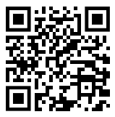
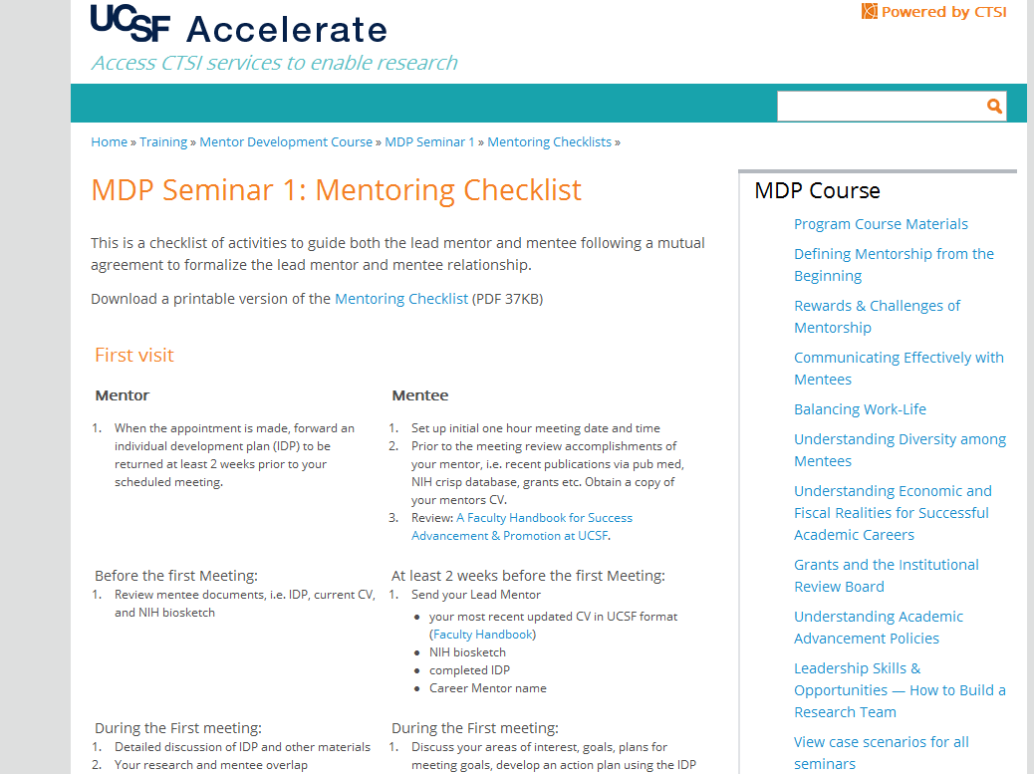
Resources from UCSF CTSI mentoring program https://accelerate.ucsf.edu/training/mdp-materials
Notes:
link to put in the chat: https://accelerate.ucsf.edu/training/mdp-materials

Slide 28
The CUGH Mentorship Program
Notes:
Purba

Slide 29
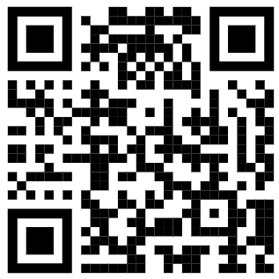
CUGH Mentorship Program
Who
Researchers, educators, practitioners, and health professionals at any level
What you’ll gain
Connections
Networks
Insights
Guidance
Sign up here!
How pairs will connect
Remotely
Time frame
Apply by May 30
Pairs notified in June – begin connecting once paired
https://www.surveymonkey.com/r/ZWQ875H
Notes:
Link for chat box
https://www.surveymonkey.com/r/ZWQ875H

Slide 30
Summary
5
CUGH Mentorship Program
1
Attributes of effective mentors and mentees
4
Mentoring resources and frameworks
2
Characteristics of successful mentor-mentee partnerships
3
Potential challenges in mentoring relationships

Slide 31
References
Luchuo Engelbert Bain, Brenda Mbouamba Yankam, Jude Dzevela Kong, Ngwayu Claude Nkfusai, Oluwaseun Abdulganiyu Badru, Ikenna Desmond Ebuenyi, Azeez Butali, Nicholas Kofi Adjei, Oluwafemi Adeagbo - Global Health Mentorship: Challenges and Opportunities for Equitable Partnership: BMJ Global Health 2023.
Varkey, P. et al. The positive impact of a facilitated peer mentoring program on academic skills of women faculty. BMC Med. Educ. 12, 14; 2012.
Sciences NAO. Advisor, teacher, role model, friend: On being a mentor to students in sciences and engineering. Washington, DC: National Academy of Sciences; 1997.
SCOPME. Standing committee on postgraduate medical and dental education. An enquiry into mentoring. A SCOPME report. London: London Department of Health; 1998.
A new path to mentorship for emerging global health leaders in low-income and middle-income countries. Hamid, Meherunissa et al. The Lancet Global Health, Volume 10, Issue 7, e946 - e948; 2022.
Hansoti B, Kalbarczyk A, Hosseinipour MC, et al. Global health mentoring toolkits: a scoping review relevant for low-and middle-income country institutions. Am J Trop Med Hyg; 100 (suppl): 48–53;2019.
Hamid, Meherunissa et al. A new path to mentorship for emerging global health leaders in low-income and middle-income countries. The Lancet Global Health, Volume 10, Issue 7, e946 - e948. 2022.
Pfund C, House S, Asquith P, Spencer, K, Silet K, Sorkness C. (2012) Mentor Training for Clinical and Translational Researchers. W.H. Freeman.
Pfund C, House S, Spencer K, Asquith P, Carney P, Masters K, McGee R, Shanedling J, Vecchiarelli S, Fleming M. A Research Mentor Training Curriculum for Clinical and Translational Researchers. Clin Trans Sci 2013; 6:26-33
Fleming M, House S, Hanson VS, Yu L, Garbutt J, McGee R, Kroenke K, Adebin Z, Rubio D. The Mentoring Competency Assessment: Validation of a New Instrument to Evaluate Skills of Research Mentors. Acad Med, 2013;88(7): 1002-1008.
Sorkness CA, Pfund C, Asquith P, Drezner M. Research Mentor Training: Initiatives of the University of Wisconsin Institute for Clinical and Translational Research. Clin Transl Sci. 2013;6(4):256-258.
Pfund C, House SC, Asquith P, Fleming MF, Buhr KA, Burnham EL, Eichenberger Gilmore JM, Huskins WC, McGee R, Schurr K, Shapiro ED, Spencer KC, Sorkness CA. Training Mentors of Clinical and Translational Research Scholars: A Randomized Controlled Trial. Acad Med. 2014; 89:774-782.
Pfund, C., Spencer, K., Asquith, P., House, S., Miller, S., Sorkness, C. (2015). Building National Capacity for Research Mentor Training: An Evidence-Based Approach to Training-the-Trainers. CBE Life Sciences Education 14 (2).
Tobin MJ, Mentoring: Seven Roles and Some Specifics. Am J Respir Crit Care Med, 2004; 170(2).
National Academies of Sciences, Engineering, and Medicine; Policy and Global Affairs; Board on Higher Education and Workforce; Committee on Effective Mentoring in STEMM; Dahlberg ML, Byars-Winston A, editors. The Science of Effective Mentorship in STEMM. Washington (DC): National Academies Press (US); 2019 Oct 30. 2, The Science of Mentoring Relationships: What Is Mentorship? Available from: https://www.ncbi.nlm.nih.gov/books/NBK552775/
Notes:
‹#›

Slide 32
Discussion and Questions
Sign up for the CUGH Mentorship Program:
https://www.surveymonkey.com/r/ZWQ875H

Slide 33
Social Cognitive Career Theory
Mentorship Best Practices
Communicate effectively
Align expectations
Foster independence
Promote growth & development
Address issues of diversity
Notes:
Social Cognitive Career Theory (and some early research) suggests that a trainee’s self-efficacy can be increased through positive career experiences such as “personal experiences of success, exposure to and mentoring by successful role models, positive reinforcement, and positive affective experiences during activities related to career goals”
– therefore, mentors can play a vital role in increasing a student’s self-efficacy and career success
Effective communication:
Effective communication is regular
Both parties actively listen
Mentees should communicate why they want mentoring and their goals for being mentored (e.g., grow certain skills, guidance in career path, connections, etc.)
Mentors should be approachable and available
Align expectations
At the beginning, discuss goals and parameters of the mentoring relationship - do not assume anything
Discuss frequency and type of communication
Discuss responsibilities - Who is responsible for what (setting meetings, agenda, report form, etc.)?
Foster independence
Mentor: Provides different and broader perspectives;
Mentee: Asks challenging questions to help uncover real issues and stumbling blocks; Mentee: is honest about challenges
Mentor: Provides encouragement and constructive criticism / options to move forward; Mentee: is open minded to guidance; accepts and incorporates feedback
Mentor: Encourages critical and strategic thinking
Allow mentee to guide relationship
Promote development and growth
Share information on opportunities to acquire new skills; Encourage interaction with other professionals and researchers
Commit to being a supportive colleague during the defined mentoring, and to the extent possible, throughout his/her professional life
Address issues of diversity
Unconscious bias
Be aware of issues faced by mentees from diverse backgrounds
Recognize that there maybe multiple career options (aside from your path) and provide assistance in exploring

Slide 34
GROW: A framework for mentoring conversations
Goal
What the mentee wants to achieve (specific and measurable – “SMART” goals)
Reality
Where the mentee is currently (their ‘reality’)
Obstacles/Options
What ‘obstacles’ keep the mentee from achieving goals and what 'options’ are available to overcome these issues
Way forward
What steps are needed to execute the chosen option and achieve the goal
Adapted from Alexander, G.; Fine, A.; & Whitmore, J.
Notes:
Mentoring is collaborative; mentees are not passive recipients of a mentor’s guidance. Ideally, mentees and mentors engage as partners through reciprocal activities such as planning, acting, reflecting, questioning, and problem-solving. This dynamic relationship changes over time,
Goal A specific and measurable endpoint that the mentee wants to attain.
Reality The situation the mentee is in and the issues he or she is currently facing. Obstacles/Options Obstacles keeping the mentee from attaining the goal and what 'options' are available to resolve this issue.
Way forward The required steps needed to execute the chosen option and attain their goal.
Foster independence
Mentor: Provides different and broader perspectives;
Mentee: Asks challenging questions to help uncover real issues and stumbling blocks; Mentee: is honest about challenges
Mentor: Provides encouragement and constructive criticism / options to move forward; Mentee: is open minded to guidance; accepts and incorporates feedback
Mentor: Encourages critical and strategic thinking
Allow mentee to guide relationship
Promote development and growth
Share information on opportunities to acquire new skills; Encourage interaction with other professionals and researchers
Commit to being a supportive colleague during the defined mentoring, and to the extent possible, throughout his/her professional life

